Slide 1
From Clinical Data to Knowledge: Building a Semantic Foundation for Healthcare Interoperability
Kaohsiung Medical University Hospital
March 24, 2026
Stanley M. Huff, MD
Professor (Clinical) Department of Biomedical Informatics, University of Utah School of Medicine
Chair, Clinical LOINC Committee
Notes:
Welcome Back
We hope you enjoyed that excellent and thought provoking keynote by Dr. Ehrenfeld that definitely left us with some important call to actions.
And we hope you have had some time during the break for networking.
Now we would like to move to the next part of the program and talk about our vision for LOINC.
Earlier in the year, we celebrated LOINC’s 30th anniversary which is a tremendous milestone of 30 years of working together to improve health data and interoperability for better care and better health.
That was a time to reminisce, now we would like to take some time to look forward and talk about where LOINC is going next.
I am going to talk about where we are headed strategically and then Stan Huff, who Chairs the LOINC Clinical Committee will drill down a bit more and talk about where we are going with LOINC in terms of its content and concept model and the changes we are proposing to LOINC so that it continues to grow and evolve to meet the needs or interoperability, particularly semantic interoperability.

Slide 2

Who am I?
  Physician - Board Certified in Clinical Pathology and Medical Informatics
  Medical Informaticist at Intermountain Healthcare for 36 years, CMIO for the last 12 years
  Professor (Clinical) U of Utah Department of Biomedical Informatics
  Founding Member and Co-chair of Logical Observation Identifiers Names and Codes (LOINC)
  Former member of SNOMED CT Editorial Board
  Past Chair of Health Level 7 (HL7) (twice)
Selfie, Dead Horse Point
Notes:
Note that you were also employed at AT&T Bell Laboratories
How many PhD students?
Also mention SHIELD (LIDR), Sequoia (Interoperability Matters steering committee)

Slide 3
Why Semantic Interoperability?
Help people live the healthiest lives possible.
(Intermountain Health Mission Statement)
  Improve the quality of care
  Decrease the cost of care
  Increase the efficiency of care
  Enable a Learning Health System
  Make providers happier
  Make people (customers, consumers) healthier and happier

Slide 4
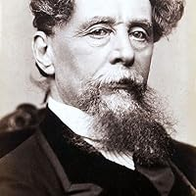
“It was the best of times, it was the worst of times, …
“… it was the age of wisdom,
it was the age of foolishness,
it was the epoch of belief,
it was the epoch of incredulity,
it was the season of light,
it was the season of darkness,
it was the spring of hope,
it was the winter of despair.”
― Charles Dickens, A Tale of Two Cities

Slide 5
The best of times …

Slide 6
We are on the verge of a new era, enabled by:
  Computer science
    Baysian networks, neural networks, CDS, ML, AI, Ambient AI, Agentic AI, NLP …
  Development of standards
    SNOMED CT, LOINC, UCUM, HL7 (FHIR, CCDA, V2.X)
  Unprecedented support from
    Providers
    Software vendors
    Professional societies
  Legislation and regulations
    Value based care – pay for value, not volume

Slide 7
The worst of times …

Slide 8
Typical Configuration Today
(Organization Centric Architecture)
Patient
A patient’s data is scattered across multiple systems
Redundant copies of data
Losey data transforms
No way to correct errors across
systems
System #1
System #2
Inpatient
EHR
Outpatient
EHR
HL7 FHIR
Exchange
Inpatient
EHR
Outpatient
EHR
…
Consolidated
Common Platform
Consolidated
Common Platform
Notes:
Clinicians are not shown in the picture

Slide 9
Person Centric Architecture
(simplified)
Patient data in only one place.
All data stores/updates are via open standard APIs.
No duplication of data.
Flexible and specific user interfaces for clinicians and patients.
Uniform security, privacy, authorization.
Patient
Clinician UI
The focus is on universal access, not exchange.
Patient UI
Clinician UI
System #1
System #2
Inpatient
EHR
Outpatient
EHR
HL7 FHIR
APIs
Inpatient
EHR
Outpatient
EHR
Consolidated
Common Platform
Personal Health Record
“Digital Twin”
“Health Vault”
All Patient Data
Consolidated
Common Platform
Notes:
Clinicians are not shown in the picture

Slide 10
Medicine in Denial
“The complexity of modern medicine exceeds the inherent limitations of the unaided human mind.”
Eddy, DM. "Practice policies: where do they come from?" JAMA 263.9 (1990): 1265-1275.
“... man is not perfectible. There are limits to man’s capabilities as an information processor that assure the occurrence of random errors in his activities.”
McDonald, CJ. "Protocol-based computer reminders, the quality of care and the non-perfectability of man." New England Journal of Medicine 295.24 (1976): 1351-1355.
“A culture of denial subverts the health care system from its foundation.”
Weed LL, Weed L. “Medicine in Denial.” Page 1. Published by Createspace. ISBN: 145617061. ISBN-13:
9781456417062.
It is is estimated waste accounts for ~25% of annual healthcare expenditures.
Shrank WH, Rogstad TL, Parekh N. Waste in the US Health Care System: Estimated Costs and Potential for Savings. JAMA. 2019;322(15):1501–1509. doi:10.1001/jama.2019.13978
CDS that is enabled by SI can extend the natural abilities of human doctors beyond what is theoretically possible.

Slide 11
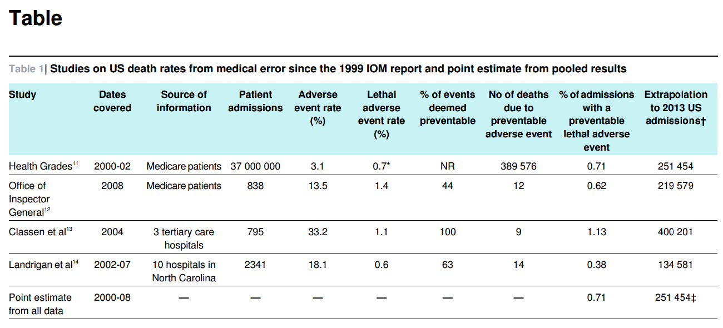
Medical Error – Third Leading Cause of Death in the US
BMJ 2016; 353:i2139 (Published 3 May 2016)
Physicians Do the Right Thing ~50% of the Time
McGlynn EA, Asch SM, Adams J, Keesey J, Hicks J, DeCristofaro A, Kerr EA. N Engl J Med. 2003 Jun 26;348(26):2635-45.

Slide 12
What do I mean by “semantic interoperability”?

Slide 13
The Interoperability Pyramid
Semantic
Interoperability
1 Preferred structure, extensions, explicit LOINC and SNOMED, units, magnitude, …
FHIR Compliance
Structure(s), extensions and some specific LOINC and SNOMED
HL7 FHIR Compliance
Structure(s), Generic LOINC
HL7 Version 2 Compliance
Structure, No terminology Constraints

Slide 14
Plug-and-Play Interoperability
The ultimate goal is to achieve the same level of knowledge and application sharing that is provided by the Apple App Store - the ability to download, install, and immediately begin using a new application.
It should not require special mapping from local terms and codes to standard terms and codes.
“Plug and Play” < 5 days
2023 Clinical Informatics Conference | amia.org

Slide 15
Even beyond “plug and play” … standardization of all health-related data, information, and knowledge
Use cases we need to support:
Realtime direct patient care
“Patients like me”
Realtime clinical decision support (CDS)
Automated updating of executable medical knowledge -especially CDS (ala Bill Stead)
Automated:
  Public health reporting
  Quality Improvement
  Quality Assurance
Improved data input as the basis for training AI
Public health reporting
Clinical research
  Enrollment in clinical trials
  Population analytics
  Learning health system
Post market drug surveillance
Drug repurposing (off label use)
Administrative tasks
  Supply chain – decrement inventory
  Billing

Slide 16

Interoperability Today
Legend:
shape = structure
color = terminology
Real World
Digital
World
Data Sharing and Re-use
Application

Slide 17
Interoperability in the Future
Real World
Digital
World
Data Sharing and Re-use
(no translation, just use it!)
Application
Legend:
shape = structure
color = terminology

Slide 18
How do we get to semantic interoperability?

Slide 19
Medical Reasoning
Immuno-compromised patient
Tertiary
Inferences
process
Secondary
Inferences
Acute streptococcal pharyngitis
increased WBC
“The beginning of wisdom is the ability to call things by their right names.”
~ Confucius
Veale J. J Am Acad Gold Foil Operators. 1974;GF17(GF2):45-80.
inflammation
fever
First Level
Inferences
positive strep culture
process
process
temperature = 38.9
cervical
lymph-
adenopathy
Primitive Data
beta
hemolytic
colonies
redness
WBC = 11.8
sore
throat
Perceptions
visual
intensity
size
voltage
pain
size
color
heat
shape
shape
Notes:
42

Slide 20
Textbook knowledge vs. executable knowledge
Textbook knowledge (the pathogenesis of disease)
  Diabetes mellitus, also known as diabetes, is a chronic disease that occurs when the body can't control blood sugar levels. This can be due to the body not producing enough insulin, or not using insulin properly.
Executable knowledge (how you know in the real world if your patient is diabetic)
  The patient has diabetes mellitus if {
  the hemoglobin A1c is 6.5% or greater
  OR they require insulin to control their blood sugar
  OR … }
Both types of knowledge are essential, …
  But executable knowledge is needed to make clinical decision support applications shareable, and is the key to computers applying textbook knowledge to individual patients.

Slide 21
But there are too many ways to say the same thing.

Slide 22
Systolic Blood Pressure Example
Systolic blood pressure. There are 122 active terms for systolic blood pressure in LOINC
8480-6 Systolic blood pressure
8461-6 Systolic blood pressure--supine
8460-8 Systolic blood pressure--standing
8459-0 Systolic blood pressure—sitting
89268-7 Systolic blood pressure—
lying in L-lateral position
76215-3 Invasive Systolic blood pressure
76534-7 Systolic blood pressure by Noninvasive
8479-8 Systolic blood pressure by palpation
8508-4 Brachial artery Systolic blood pressure
8510-0 Femoral artery Systolic blood pressure
75997-7 Systolic blood pressure by Continuous
non-invasive monitoring
8450-9 Systolic blood pressure--expiration
8451-7 Systolic blood pressure--inspiration
87739-9. Systolic blood pressure--W exercise
89280-2 Systolic blood pressure—
during anesthesia
87741-5 Systolic blood pressure--post exercise
45372-0 Blood pressure systolic and diastolic—
post phlebotomy
50403-5 Blood pressure systolic and diastolic—
before transfusion
50402-7 Blood pressure systolic and diastolic—
after transfusion

Slide 23
Systolic BP LOINC codes
{BP Method}
8480-6 | Intravascular systolic | Pres | Pt | Arterial system | Qn
76215-3 | Intravascular systolic | Pres | Pt | Arterial system | Qn | Invasive
76534-7 | Intravascular systolic | Pres | Pt | Arterial system | Qn | Noninvasive
8479-8 | Intravascular systolic | Pres | Pt | Arterial system | Qn | Palpation
75997-7 | Intravascular systolic | Pres | Pt | Arterial system | Qn | CNAP
8459-0 | Intravascular systolic^sitting | Pres | Pt | Arterial system | Qn
8460-8 | Intravascular systolic^standing | Pres | Pt | Arterial system | Qn
Method {BP Method}
Invasive
Noninvasive
Palpation
CNAP
Patient Position {BP Pt Position}
Sitting
Standing

Slide 24
Systolic BP Instance Data
Option #1
(pre coordinated)
Option #2 Preferred
(post coordinated)
  Observation
  code: 8459-0, Systolic BP Sitting
  value: 120 mmHg
  Observation
  code: 8480-6, Systolic BP
  value: 120 mmHg
  bodyPosition: Sitting position (finding)
  (SNOMED CT#33586001)
If you adhere to HL7 FHIR, LOINC, SNOMED CT, and UCUM
you still have multiple ways to represent the same information!

Slide 25
Proliferation of FHIR Profiles and Extensions
From Mark Kramer, “Reducing FHIR ‘Profiliferation’: A Data-Driven Approach, AMIA Annual Meeting 2022
Rank | Resource | Total Profiles | Profiled Data Elements | No. of Extensions
1 | Observation | 502 | 11,229 | 340
2 | Bundle | 130 | 1,878 | 0
3 | Composition | 85 | 6,779 | 347
4 | Condition | 82 | 1,360 | 91
5 | Patient | 74 | 2,361 | 302
6 | Organization | 67 | 1,589 | 121
7 | Practitioner | 53 | 1,226 | 54
8 | Location | 36 | 654 | 15
9 | PractitionerRole | 35 | 829 | 28
10 | ServiceRequest | 35 | 1,284 | 57
11 | Procedure | 33 | 671 | 66
12 | Task | 26 | 554 | 36
13 | Device | 26 | 585 | 21
All profiles* |  | 1,961 | 46,897 | 2,793

Slide 26
We need one preferred model for a specific data element
(blood pressure, serum glucose, penicillin prescription, …)
This means we need 10’s of thousands of models!

Slide 27
Why semantic models first?
Semantic models change slowly, but data exchange standards change rapidly (we are balloting FHIR V6 now)
Many different data exchange standards can be generated from the semantic models (HL7 V2.X, HL7 FHIR, CDA, CDISC, …)
Computable medical algorithms, rules, decision logic, and knowledge are based on the foundation of semantic models
  Software has few changes during rapid changes of exchange standards
  Software should reference semantic models in their logic, not exchange standards
Everything we know comes from observing the real world
Notes:
Dutch information models, Michael van der Zel, zibs, https://zibs.nl/wiki/HCIM_Release_2024(EN)

Slide 28
Model Development Workflow
Narrative Health Records
Structured Health Records
Journal Articles
Textbooks
Existing Models
Terminology
Server
Draft 2
Value Set Creation and
Terminology
Mapping
NLP
LLMs, Generative AI
Silver
Draft Models
Model
Library
Human
Review
(Minimize!)
Bronze
Gold

Slide 29
Development of Technology Specific Artifacts
Transformation
Knowledgebase
HL7 FHIR
Profiles
(V1 – V6)
HL7 V2.X
IGs
Model
Library
Model
Transform
C-CDA
Templates
OMOP
Format
Others
Notes:
Defining the structural knowledge of medical data is the hard job. It is relatively easy to create cross compilers that create the different exchange syntaxes.

Slide 30
Using models in applications
The developer queries the library of models constrained for specific use cases, NOT a library of codes and terms
The developer selects the model appropriate for their use case
The developer sees the model in their choice of language, and they see only the attributes of the model that pertain to their use case, and only the allowed attribute values that are allowed for that use case
The developer uses the API associated with the model to define queries to retrieve data, reason about data, or to fill out the values for storage of new data in a database

Slide 31
The knowledge sharing paradigm today
Research and clinical experience
Publication in textbooks and peer reviewed journals
Clinicians read the books and journals
The clinicians see patients and apply the knowledge they gained from reading the information
This paradigm doesn’t work!
Clinicians do the right thing ~50% of the time.

Slide 32

A future process of knowledge sharing
Create an application that applies the knowledge
Application for detecting and managing sepsis in the emergency department
Basic and observational
research
The application:
Is aware of the patient’s situation
Determines whether the knowledge is applicable
Creates a recommendation
Implements the correct action

Slide 33
Implications of SI for clinical research
  We should provide academic recognition for development of executable knowledge in the same we do peer reviewed publications today
  Executable knowledge is not lost when a clinician retires or dies, it is an asset of all the citizens of the world
  Groups naturally work together as teams on topics of common interest
  Applications will be ever improving, and everyone in the world can benefit immediately from the new knowledge

Slide 34
Implications of SI for health education
  Move away from memorization of facts
  Teach people to use information resources of all kinds
    Computable guidelines
    ChatGPT, Claude, …
  Greater emphasis on acquiring accurate information from the patient
    “people skills” and communication
    observation and physical exam
  Evaluate clinicians based on: outcomes (the ability to do the right thing), utilizing their exam and interpersonal communication skills, use of AI and clinical decision support integrated in the workflow

Slide 35
Implications of SI for society
  Dramatically improved quality of medical care
  Dramatically decreased cost of health care
    Do the right thing the first time
    Prevent unnecessary tests and treatments
  Enable more accurate medical AI (better training data)
  Ensure unbiased care for all patients regardless of race, ethnicity, age, religion, or sexual preference

Slide 36
The semantic modeling approach has been used at Intermountain for over 40 years
The HELP System used PTXT (Pointer to TeXT) as its semantic model (40+ years)
HELP² used an ASN.1 model library as its semantic model (20+ years)
Our current best approach is using Clinical Element Models (CEMs) as our semantic models

Slide 37
The Final Mile to Semantic Interoperability
  A community committed to implementing semantically interoperable solutions
  Continued support for standards (especially LOINC, SNOMED CT, UCUM, HL7 FHIR and other data exchange standards)
  An open library of preferred HL7 FHIR profiles
    A single preferred profile for a given context of use
    The ability to transform data from alternative representations
  Certification of apps and services as being plug-and-play interoperable in production environments
  An open marketplace for sharing of apps and knowledge
  We can provide value very quickly, but to be comprehensive may take years (3?, 5?, 7?, 10?)

Slide 38
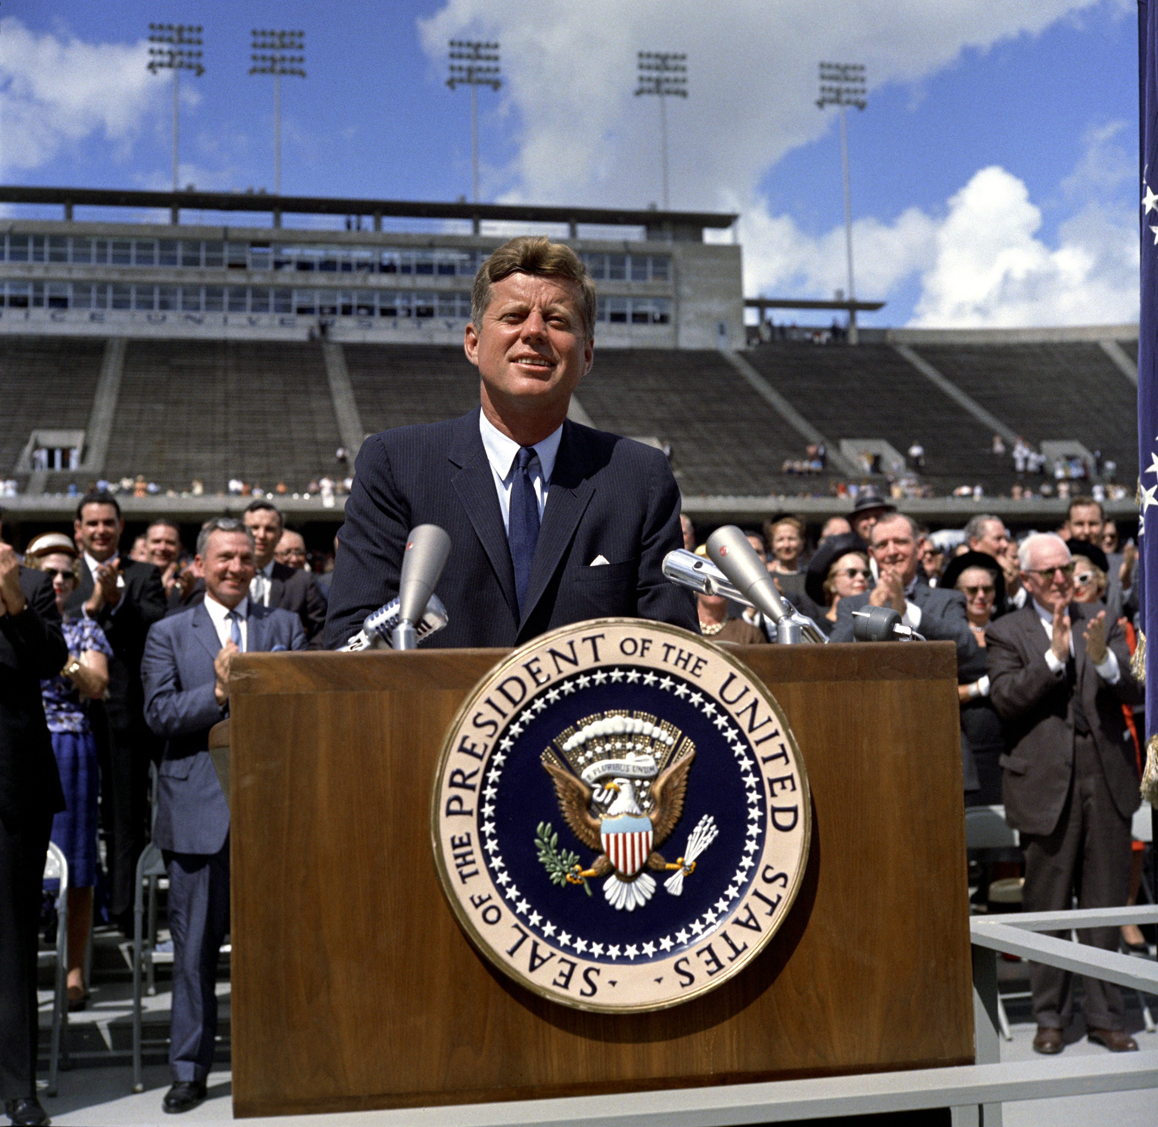
Completing the final mile will be hard, but …
“We choose to go to the moon in this decade …, not because [it is] easy, but because [it is] hard, because that goal will serve to organize and measure the best of our energies and skills, because that challenge is one that we are willing to accept, one we are unwilling to postpone, and one which we intend to win …”
President John F. Kennedy, Rice University, September 12, 1962
Notes:
We choose to go to the moon. We choose to go to the moon in this decade and do the other things, not because they are easy, but because they are hard, because that goal will serve to organize and measure the best of our energies and skills, because that challenge is one that we are willing to accept, one we are unwilling to postpone, and one which we intend to win, and the others, too.

Slide 39
A final thought …

Slide 40
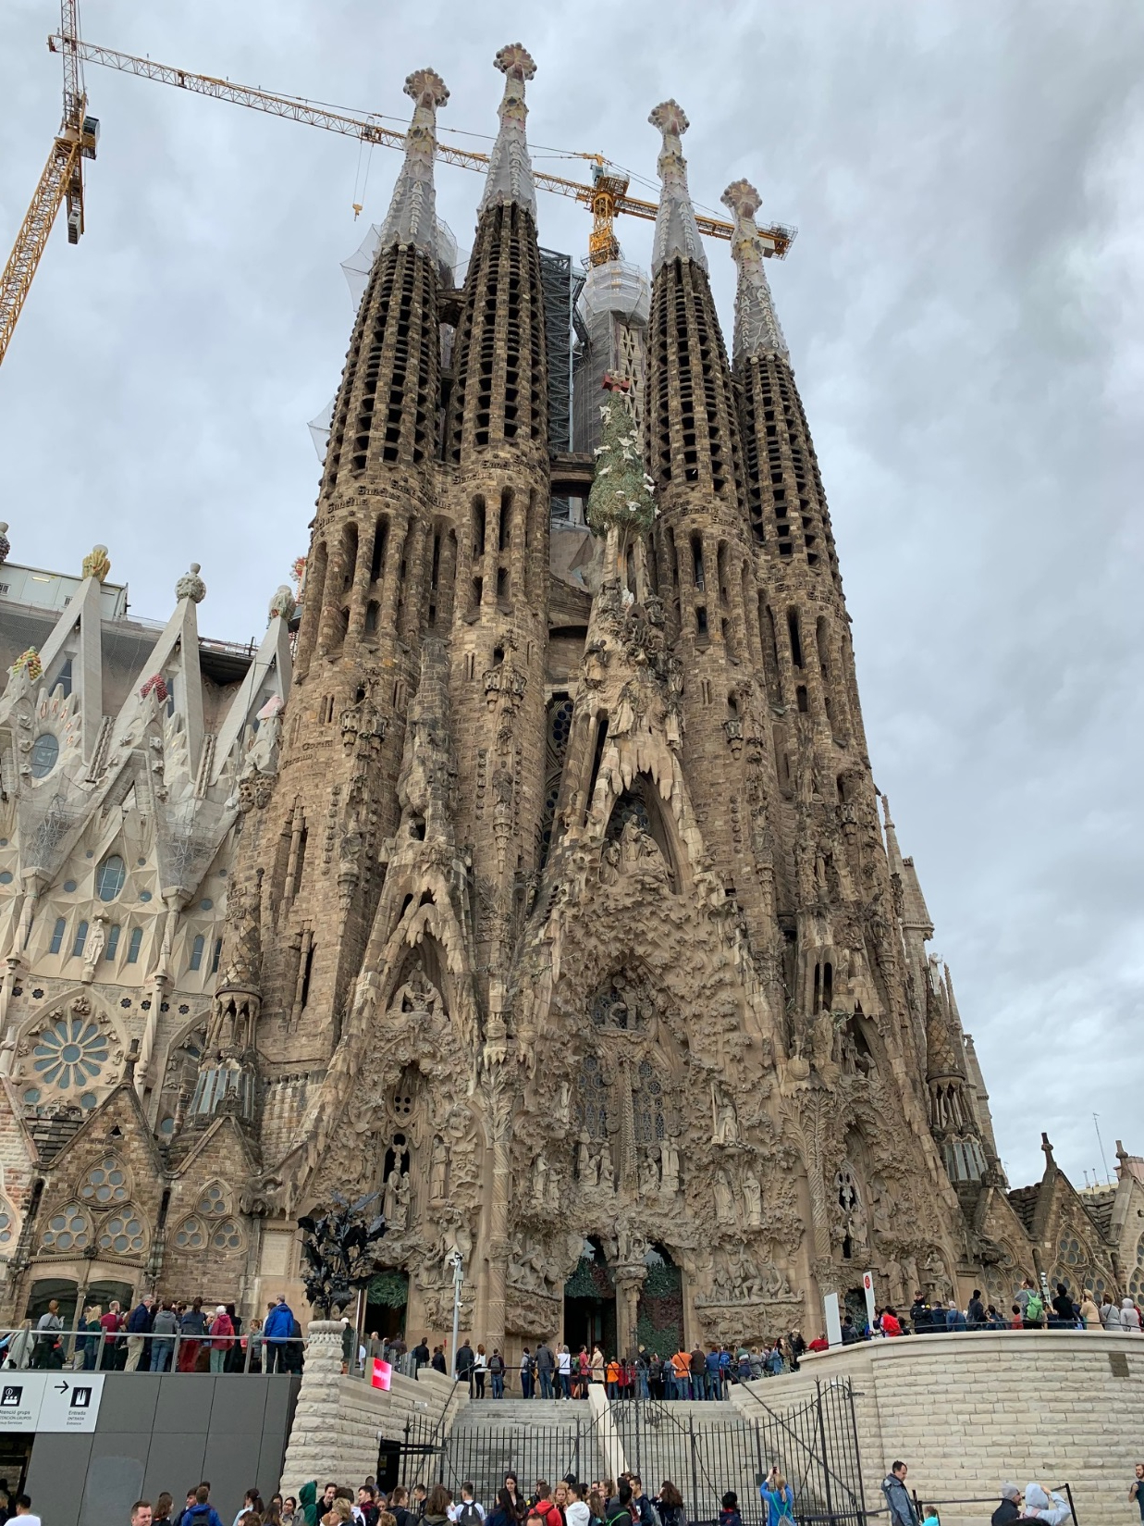
LOINC Meeting October 2019 in Barcelona, Catalonia, Spain
-------------------------
La Sagrada Familia

Slide 41

An invitation I received after my visit.

Slide 42
We are involved in a movement, a campaign…
“To do things right, first you need love, then technique.”
“What must be always preserved is the spirit of the work; its life will depend on the generations that transmit this spirit and bring it to life.”
Antoni Gaudi, Architect of La Sagrada Familia
(1852 to 1926)
33

Slide 43

Wrap-Up and Q&A

Slide 44
Appendix

Slide 45
Translation maps for isosemantic models

Slide 46
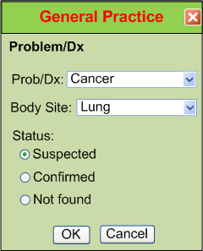
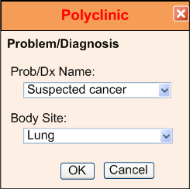
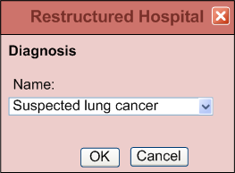
Different approaches for representing isosemantic data
(from Dr.Linda Bird)
“Suspected Lung Cancer”

Slide 47
Example instance data for “Suspected Lung Cancer”
Option #1
Option #2 - Preferred
  Condition
  code: Suspected lung cancer
  (SCT 162573006)
  Condition
  code: Cancer (SCT 363346000)
  system: Lung (SCT 39607008)
  certainty: Suspected
  (SCT 415684004)

Slide 48
Process for creating isosemantic maps
Pre-coordinated disease model
SNOMED CT
Lookup
  Disease: Suspected lung cancer
  (SCT 162573006)
Suspected lung cancer
Associated finding → Lung Cancer
Finding context → Suspected
Post-coordinated disease model
  Disease: Cancer (SCT 363346000)
  Location: Lung (SCT 39607008)
  Context: Suspected (SCT 415684004)
Finding site → Lung
Associated morphology → Cancer
Computable map of pre to post coordinated data
IF (Pre-coordinated_disease_model.Disease == 162573006) THEN {
Post-coordinated_disease_model.Disease = 363346000;
Post-coordinated_disease_model.Location = 39607008;
Post-coordinated_disease_model.Context = 415684004;}
Notes:
This method can only be used for concepts where the relationships exist in current medical ontologies

Slide 49
Isosemantic map knowledgebase
Pre-coord
code
Information model
Post-coord elements
Post-coord codes
code: Suspected Lung Cancer | 162573006 (SCT) | Cancer | 363346000 (SCT)
 |  | Lung | 39607008 (SCT)
 |  | Suspected | 415684004 (SCT)
code: Lung Cancer certainty: Suspected | 363358000 (SCT) 415684004 (SCT) | Cancer | 363346000 (SCT)
 |  | Lung | 39607008 (SCT)
 |  | Suspected | 415684004 (SCT)

Slide 50
Transformation of Patient Data
Data Transformation
Knowledgebase
Patient data output
Patient data input
  FHIR Condition
  patient: Doe, John
  code: Cancer (SCT 363346000)
  system: : Lung (SCT 39607008)
  certainty: Suspected
  (SCT 415684004)
  FHIR Condition
  patient: Doe, John
  code: Suspected lung cancer
  (SCT 162573006)
Data
Transform Widget
Notes:
Defining the structural knowledge of medical data is the hard job. It is relatively easy to create cross compilers that create the different exchange syntaxes.

Slide 51



Open Interoperability Ecosystem
STANDARDIZATION & POLICY
Development Lab
MARKETPLACE
MODEL DEV. SERVICES
Open
STANDARD
ENGAGEMENT SERVICES
DEVELOPMENT ENVIRONMENT
Compliance CERTIFICATION
CERTIFIED
APPLICATIONS
INTEROPERABILITY PLATFORM
APPLICATION PLATFORM
Patient Data
Sources
STANDARDIZATION
SERVICE
DATA MANAGEMENT
SERVICE
FHIR
INTERNAL APPLICATIONS
PURCHASED APPLICATIONS
Includes Generative and
Agentic AI
Could be
a PHR
MEMBER SYSTEM FIREWALL
SHARED TRUST ENVIRONMENT

Slide 52
Limitations of FHIR?
The best data exchange standard we have ever had, but…
Already to V6
Design by committee
Slow development
Does not follow known OO modeling guidelines
Inconsistent elements across FHIR resources and profiles
Scope is data exchange, not all data for representing health care processes

Slide 53
The way it might work …
  Name: Jane Doe Sex: F DOB: 4 Nov 1952
Data to report
Health Issues
IDDM
ASHD due to #1
Mild CKD due to #1
HgbA1C (graph)
Glucose (graph)
Diabetic meds
All meds
GFR (last)
GFR (graph)
Date of last retinal exam
More …

Slide 54

The way it might work …
  Name: Jane Doe Sex: F DOB: 4 Nov 1952
#1 Super Specialist
Best DM Care APP
Care Registry
Health Issues
IDDM
ASHD due to #1
Mild CKD due to #1
Data to report
HgbA1C (graph)
Glucose (graph)
Diabetic meds
All meds
GFR (last)
GFR (graph)
EHR
1
EHR
2
EHR
3
More …
Date of last retinal exam

Slide 55
Analogies for our current situation …
Trying to build homes without a measuring tape
Sharing literature prior to the printing press
Astrophysics before there were telescopes
Chemistry (alchemy) before we understood atomic theory and the periodic table
Understanding infectious diseases before there were microscopes and germ theory

Slide 56
The Beginning of Wisdom …
“The beginning of wisdom is the ability to call things by their right names.”
Confucius
Veale J. The Beginning of Wisdom is the Ability to Call Things by Their Right Names ...CONFUCIUS. J Am Acad Gold Foil Operators. 1974;GF17(GF2):45-80.

Slide 57
Textbook knowledge vs. executable knowledge
Textbook knowledge (the pathogenesis of disease)
  Diabetes mellitus, also known as diabetes, is a chronic disease that occurs when the body can't control blood sugar levels. This can be due to the body not producing enough insulin, or not using insulin properly.
Executable knowledge (how you know in the real world if your patient is diabetic)
  The patient has diabetes mellitus if {
  the hemoglobin A1c is 6.5% or greater
  OR they require insulin to control their blood sugar
  OR … }
Both types of knowledge are essential, …
  but executable knowledge is needed to make clinical decision support applications shareable, and is the key to computers applying textbook knowledge to individual patients.

Slide 58
Artificial Intelligence
AI capabilities
  Powerful recognition of patterns – images, linguistics, processes
  Amazing ability to transform data
  Perfect memory – it never forgets
  Infinitely patient
  Never fatigues
AI limits
  Transform data to what? What representation? It needs to be defined
  How to share knowledge with people and with other computers
  It is only as good as the training data
  It currently has no way to tell truth from common beliefs or behaviors
  LLMs don’t know anything!
  “Truth is not determined by what is statistically the most common statement in a training set.”
  Frank Oemig – “Do we want data to be represented on the basis of and in conjunction with clinical knowledge (being expressed in ontologies and information models) or driven by statistics based on wording?”

