Slide 1
LOINC and Clinical Terminology: Achieving Unified Mapping Across Healthcare Enterprises
Tri-Service General Hospital
Taipei, March 25, 2026
Stanley M. Huff, MD
Professor (Clinical) Department of Biomedical Informatics, University of Utah School of Medicine
Chair, Clinical LOINC Committee
Notes:
Welcome Back
We hope you enjoyed that excellent and thought provoking keynote by Dr. Ehrenfeld that definitely left us with some important call to actions.
And we hope you have had some time during the break for networking.
Now we would like to move to the next part of the program and talk about our vision for LOINC.
Earlier in the year, we celebrated LOINC’s 30th anniversary which is a tremendous milestone of 30 years of working together to improve health data and interoperability for better care and better health.
That was a time to reminisce, now we would like to take some time to look forward and talk about where LOINC is going next.
I am going to talk about where we are headed strategically and then Stan Huff, who Chairs the LOINC Clinical Committee will drill down a bit more and talk about where we are going with LOINC in terms of its content and concept model and the changes we are proposing to LOINC so that it continues to grow and evolve to meet the needs or interoperability, particularly semantic interoperability.

Slide 2

Topics
  LOINC Overview
  SNOMED Overview
  The LOINC SNOMED Ontology
  LOINC Mapping Use Cases
© Regenstrief Institute, Inc.
Notes:
With that broader context in place, we’ll shift our focus to the core concepts and structure of LOINC.
We’ll begin with the scope of LOINC— and its primary domains.
Then we’ll ask: Why was LOINC created? What problem is it designed to solve, and how has that purpose evolved over time?
We will talk about the foundational principles that guide LOINC and why they matter,
We’ll explore how LOINC content is developed, including its structure and the guidelines and heuristics that shape LOINC.
And it is here, that we will take a deeper into
the six-axis model—explaining how it defines each LOINC concept and why this model is essential for accurately identifying and exchanging health data.

Slide 3

LOINC Overview

Slide 4

Why do we need coding of health data?
Help people live the healthiest lives possible (Intermountain Health Mission Statement)
To do that, we need to be able to use computers to collect and process data
We assume codes from terminology standards, e.g., LOINC, SNOMED CT are essential for the best use of data by computers, especially for AI
© Regenstrief Institute, Inc.
Notes:
"Let’s start with the big 'why.' Why do we code health-related data in the first place?
At its core, the goal is simple—and powerful (impactul): to help people live their healthiest lives possible.
That’s the mission of Intermountain Health, based in Salt Lake City Utah, and we selected Intermountain because its mission aptly reflects the broader purpose of the work we all do in health data standards and informatics.
To make that mission real, we need to harness the power of computers and computing to collect, process, and share data efficiently.
And that only works when the data is structured and standardized with codes that computers can interpret and act on.
This is where terminology standards like LOINC and SNOMED CT come in.
They are essential to making data usable, sharable, and actionable—enabling everything from individual care decisions to large-scale population health improvements.

Slide 5
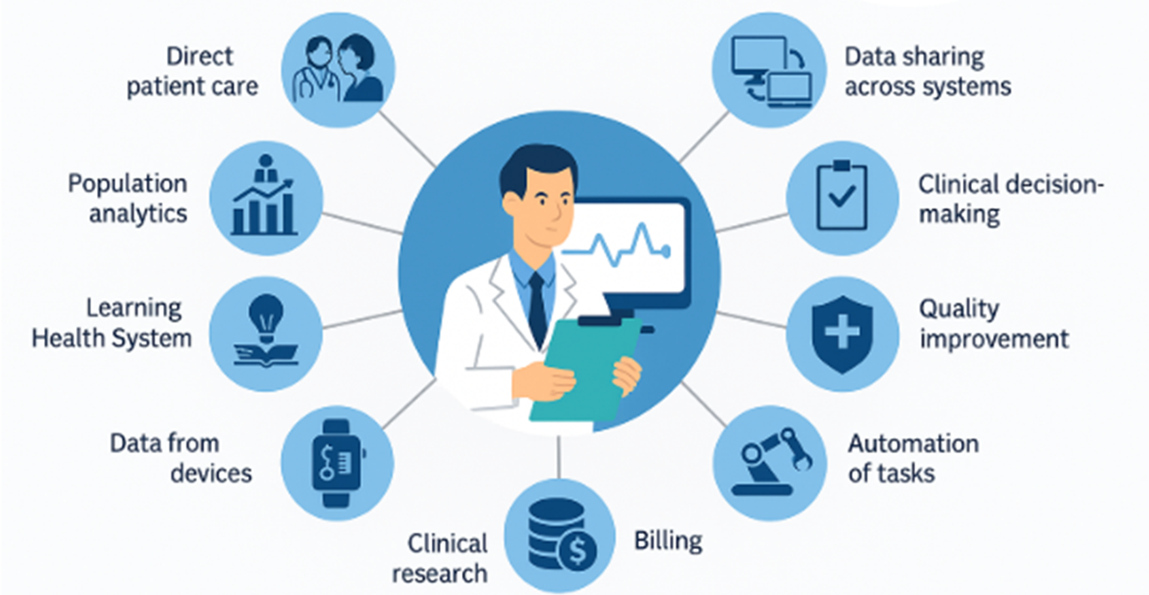

What uses of health data do we want to support?
© Regenstrief Institute, Inc.
Notes:
Keeping our focus on data,
If we ask ourselves
What uses of data do we want to support ?
The answer is ALL of them because we understand the power of health data.
We want data that improves direct patient care, enables data sharing across systems, and supports clinical decision-making at the point of care.
It’s also essential for public health reporting, quality improvement, and automating routine tasks—all of which depend on having clear, structured data.
And, as more data comes directly from devices, we need to ensure it integrates seamlessly with clinical systems.
And it doesn’t stop there. because
Health data is also vital for learning and discovery (pause)—from population analytics to supporting a Learning Health System that continuously improves based on real-world data.
Data powers clinical research, facilitates supply chain and inventory control, and yes—even supports billing and administrative workflows.
So when we say we want to support all health-related data, we mean data that serves every part of the health system—from the bedside to the back office, and everywhere in between
And at the very core of making that data usable, shareable, and meaningful [CLICK]—are data standards like LOINC.

Slide 6
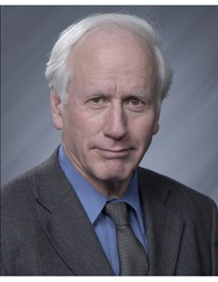
Brief history of LOINC
The global standard for identifying health
measurements and observations
Logical Observation Identifiers Names and Codes
Originated in 1994 by Clement McDonald, MD, Indianapolis, IN
Vision for health IT to help clinicians make better decisions
Need for a universal language for observations for electronic data exchange for clinical care, i.e., labs, hospitals, offices, payers
Clem McDonald, MD
© Regenstrief Institute, Inc.
Notes:
Now that we have had that background,
Lets take a deeper into LOINC and begin with some brief history.
LOINC which standards for Logical Observations, Identifiers, Names and Codes was created in 1994 and got its start at the Regenstrief Institute , in Indianapolis Indiana, and is the vision of Dr. Clem McDonald, who at the time, was Regenstrief Institute researcher.
Dr. McDonald and other thought leaders (one of whom is here with us today) had a vision that information technology should help clinicians make better decisions during the course caring for their patients.
And this vision would be realized by having a universal language called LOINC
CLICK
which today is recognized as a global standard for identifying health measurements and observations.

Slide 7
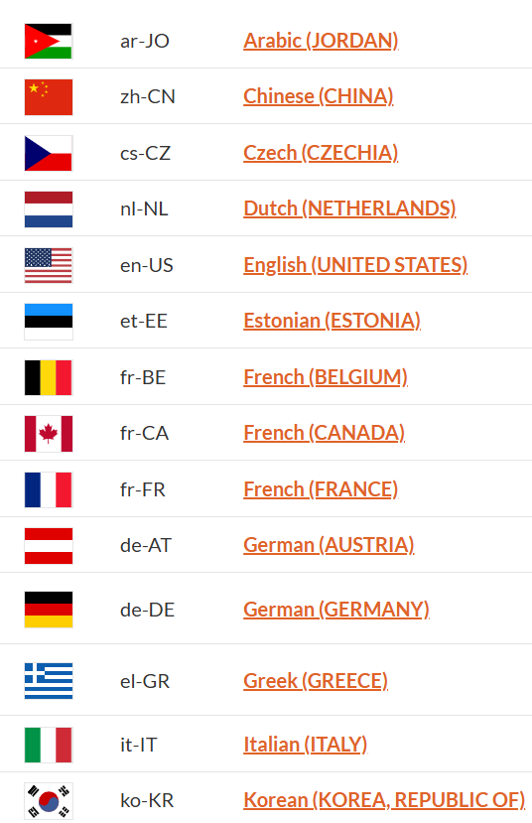
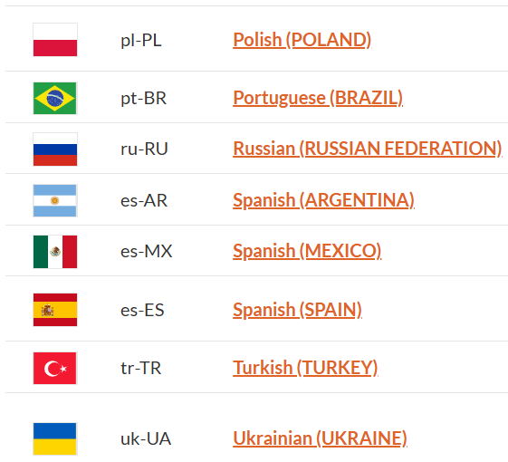
LOINC adoption around the world
LOINC is the official national standard in 30+ countries
LOINC began in the US and is now used in 196 countries
International adoption is enabled through LOINC translations
(17 languages and 22 linguistic variants)
© Regenstrief Institute, Inc.
Notes:
LOINC enjoys widespread adoption across the world, is used in more than 180 countries, and is the national standard in more than 30 countries.
And, this international adoption is enabled through LOINC translations.
There are 22 LOINC translations and there are 15 different languages

Slide 8
Scope
Over 108,000 concepts and growing
4 major categories of terms
Laboratory LOINC
Clinical LOINC
Survey Instruments
Documents
© Regenstrief Institute, Inc.
Notes:
I am going to talk about the scope of LOINC content at a high level here.
Introducing LOINC : LOINC is the database which content is the standard for Laboratory observations identifiers Names and Codes as Dr Rallins introduced previously.
LOINC Database contains over 108k concepts and is growing fast due to the need to standardized terminologies in general and for LOINC codes specifically,
There are 4 high level categories, and each category has multiple class which we will be discussing in the upcoming slides.:
1- Laboratory LOINC
2- Clinical LOINC
3- Survey Instruments
4- Documents

Slide 9
In 1994 …
HL7 was new.
For the first time, we had the HL7 data exchange standard.
But everyone was using their own local codes.
There were no standard codes for representing the meaning of the data being exchanged.
Clem convened a small group of volunteers to see if we could agree on standard codes.
© Regenstrief Institute, Inc.

Slide 10
The HL7 Messaging Paradigm
Trigger
Event
Order
System
A
System
B
Network
Result
© Regenstrief Institute, Inc.

Slide 11
HL7 V2 Result Message (ORU)
MSH|^~\&|||||19981105131523||ORU^R01|
PID|||100928782^9^M11||Smith^John^J|
OBR||||Z0063-0^BP^LN|
OBX||CE|8361-4^POSITION^LN||SIT^Sitting|
OBX||NM|8479-8^SBP^LN||138|mmHg|
Segment
Data Field
Component
© Regenstrief Institute, Inc.

Slide 12
OBX: an HL7 V2 name-value pair approach
Other data fields include, date of observation, identity of provider giving observation, normal ranges, abnormal flags
A code that identifies the datatype
of OBX-5 (Numeric)
OBX-5: Data
Status
OBX||NM|11289-6^Body Temp^LN||38|C^Cent^ISO+|||||F
A code that identifies the data in OBX-5
A code that identifies the units of numerical data in OBX-5
© Regenstrief Institute, Inc.

Slide 13
OBX: with a coded value
A code that identifies the datatype as a
coded element
The code is
from LOINC
The code is
from SNOMED
OBX||CE|883-9^Blood Group^LN||58460004^Group O^SCT|
A code that identifies the data in OBX-5
(ABO Blood Group)
OBX-5: Data
A code for Group O
© Regenstrief Institute, Inc.

Slide 14
The name-value pair pattern in the FHIR Observation Resource
Observation (abbreviated)
subject <patient identifier>
code (test code) from LOINC
value <the result of the test>
Observation (DomainResource)
identifier : Identifier [0..*]status : code [1..1]« ObservationStatus! »
code : CodeableConcept [1..1] « LOINC ?? »
subject : Reference [0..1]« Patient|Group|Device|Location »
encounter : Reference [0..1] « Encounter »
effective[x] : Type [0..1]« dateTime|Period »
value[x] : Type [0..1]
  « Quantity|CodeableConcept|string|Range|Ratio|Sampled Data|Attachment|time|dateTime|Period »
interpretation : CodeableConcept [0..1] « Observation Interpretation+ »
method : CodeableConcept [0..1] « Observation Methods?? »
Observation (data instance)
subject: Doe, John; #12345 code: 8480-6, Systolic BP
value: 120 mmHg
© Regenstrief Institute, Inc.

Slide 15
Collect result names and descriptions IH, VA, Regenstrief, May Clinic, commercial lab systems
Formulate a model Represent individual pieces of information
Create “Fully Specified Names”
Adjust concept model as needed Do any distinct entities have the same name?
Repeat process until no more adjustments are needed
Approach used for developing LOINC codes
© Regenstrief Institute, Inc.

Slide 16
General Form of Clinical LOINC Names
LOINC codes are created using a six axis model
<component> : <property> :
<timing> : <system> :
<scale> : <method>
8331-1 Body Temperature :TEMP :PT :MOUTH :QN
The first 5 parts are mandatory, but method is optional. Subparts of the six axes are created as needed in specific subject areas.

Slide 17
How different terminologies fit into data exchange models
Questions (LOINC)
Answers (from other terminologies)
(8661-1) Chief complaint:
(106203-3) Allergy:
(86255-7) Billing diagnosis:
(36908-20 Genes tested for:
(6463-4) Bacteria identified:
(41461-5) Virus identified:
Chest pain (SNOMED CT)
Penicillin (SNOMED/FDB/RxNorm)
Myocardial infarction (ICD)
Cystic fibrosis (HUGO HGNC)
Group A strep (ICSP)
Hepatitis C (ICTV)
© Regenstrief Institute, Inc.

Slide 18

SNOMED CT Overview

Slide 19
SNOMED – a short history
1965 SNOP (Systematised Nomenclature of Pathology)
1978 SNOMED (Systematised Nomenclature of Medicine)
1993 SNOMED International
2002 SNOMED CT CAP completes the merge of SNOMED RT and CTV3
2003 U.S. NLM makes SNOMED CT available to U.S. users at no cost
2007 IHTSDO acquires SNOMED CT from CAP.
2013 U.S. requires use of SNOMED CT for Meaningful Use certification
2016 IHTSDO officially adopted the trading name SNOMED International

Slide 20
Basic Elements of SNOMED CT
Concepts
Relationships
Hierarchical
Non-hierarchical
Descriptions
Notes:
There are 4 categories of building blocks of SNOMED’s structure, and concepts are SNOMED’s most basic elements.

Slide 21
SNOMED CT - Core Tables

Slide 22
Subtype relationships
Lower limb finding
Pain
Is a subtype of
Pain in lower limb
Pain in calf
A pain in the calf is-a pain in the lower limb, and
Pain in the lower limb is-a pain, and is-a lower limb finding

Slide 23
Other defining relationships
Lower limb finding
Pain
finding site
Pain in lower limb
lower limb
calf
Pain in calf
A pain in the calf has finding site calf
Pain in the lower limb has finding site lower limb

Slide 24
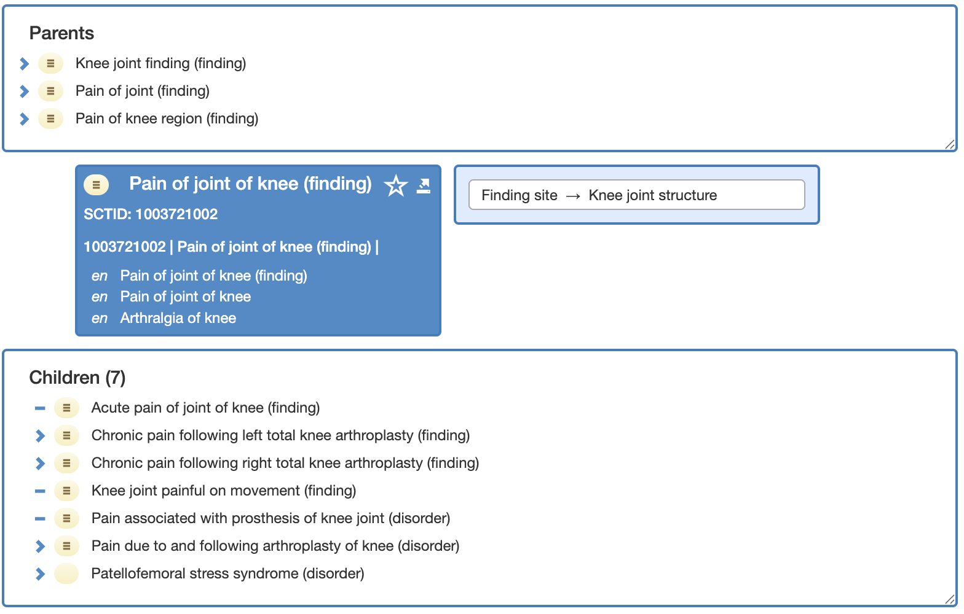
SNOMED CT: Pain of joint of knee

Slide 25

LOINC Ontology: a LOINC® and SNOMED CT® Interoperability Solution
VERSION 2.82
Notes:
Marjorie
Next, we will shift our focus to the LOINC Ontology.
This work represents an important step in strengthening the semantic foundation of LOINC and advancing more computable, connected, and scalable data use across the global ecosystem.
We continue to see strong interest and momentum in this area as the community looks for more powerful ways to represent relationships, support analytics, and enable interoperability at scale.
With that context, I am pleased to turn the floor over to Stan Huff to walk us through the latest updates.

Slide 26


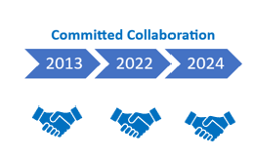
Moving Forward Together
Shared goal: Improve health and better care through standardized terminology
  Support enhanced clinical system functionality and interoperability by establishing principled relationships between SNOMED CT and LOINC
  Provide effective support for providers and users who implement different combinations of SNOMED CT and LOINC in health information systems
Notes:
Regenstreif and SNOMED International have been committed to working together to improve better heath and better care through standardized terminology for quite some time,
but a formal agreement that reflects our commitment was first initiated in 2013,
we renewed it 2022 and 2024 and future agreements are expected as well.
Our commitment to promoting the use of standardized terminologies includes supporting
enhanced clinical system functionality and interoperability by establishing principled relationships between LOINC and SNOMED CT.
And we also want to provide effective support for providers and users who implement different combinations of LOINC and SNOMED CT in health information systems
And we also want to support providers and users who implement either SNOMED CT or LOINC in their systems

Slide 27
The LOINC Ontology: A LOINC and SNOMED CT Interoperability Solution
Easy for implementers
  a unified approach to implementing both standards; choice of codes to use, for ease of implementation
Single solution
  single solution that helps meets clinical and regulatory requirements, globally
Owned & maintained by Regenstrief
  including responsibility for the model, **invaluable collaboration, ideation, SNOMED International
Extension of SNOMED CT
  SNOMED CT: ontological framework
  LOINC: content
  Implementation Guide
Distribute LOINC content to LOINC & SNOMED CT users
  Express LOINC concepts in a SNOMED CT format, with dual identifiers.
Notes:
Stan

Slide 28
Modeling and content approach & considerations
All LOINC content will eventually be in the extension
  We will incrementally add domains of information (lab, clinical, documents, radiology, survey instruments)
  We align existing SNOMED observables to LOINC codes and make new LOINC codes as needed
  We map LOINC parts to SNOMED concepts, and create new SNOMED concepts as needed
We are not creating grouper codes in the LOINC extension (we will use ECL instead)
The LOINC identifier is attached to the SNOMED concept. These are stored in an alternative identifier file.
FSNs in the LOINC Extension will be automatically created by the rules for FSNs in the International Edition of SNOMED CT according to the template
Notes:
[Marjorie]

Slide 29
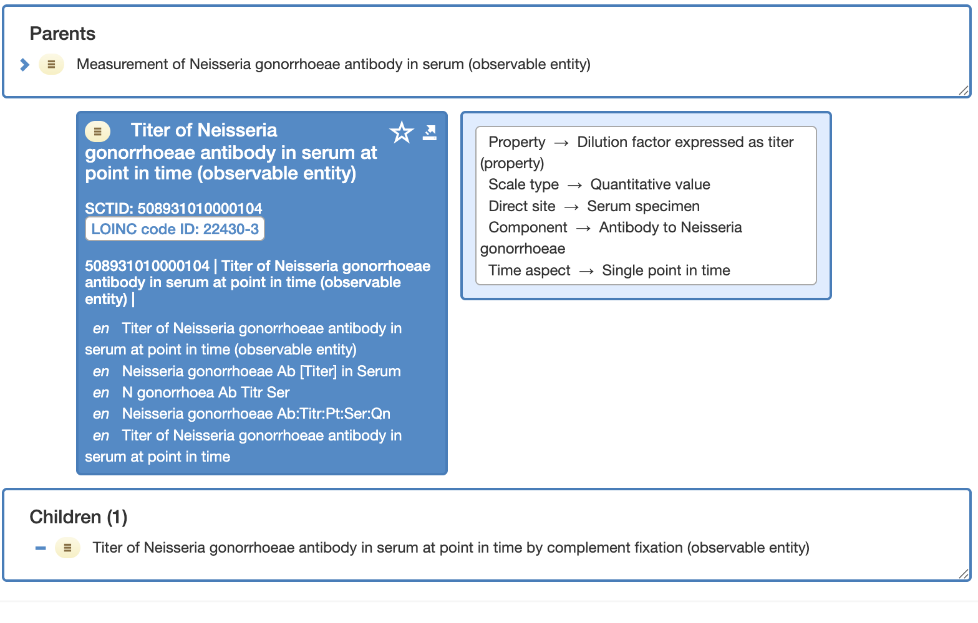
LOINC Ontology structure

Slide 30
What is in the LOINC Ontology 2.82 release?
45,000 total concepts, including 3,653 new concepts
Priority was the top 20,000 most used laboratory observations
(new) Coagulation tests, including clotting times, platelet aggregation, clotting factor assays, and clotting factor activities
The LOINC Ontology can be found at loincsnomed.org
Notes:
Stan

Slide 31
How do I make optimal use of search functionality in the hierarchy of the LOINC Ontology?
You need to become proficient in the SNOMED Expression Constraint Language (ECL)
Educational materials for ECL can be found here
Notes:
A:

Slide 32
What is a use case for the LOINC Ontology and how would I use it?
The power of the LOINC Ontology, when used with the International Edition of SNOMED CT, is that you can reason using all the relationships in SNOMED CT via the Expression Constraint Language (ECL).
Find all tests for serum electrolytes
Find all tests that can detect opioid use, or that are used to monitor therapeutic use
Notes:
A:

Slide 33
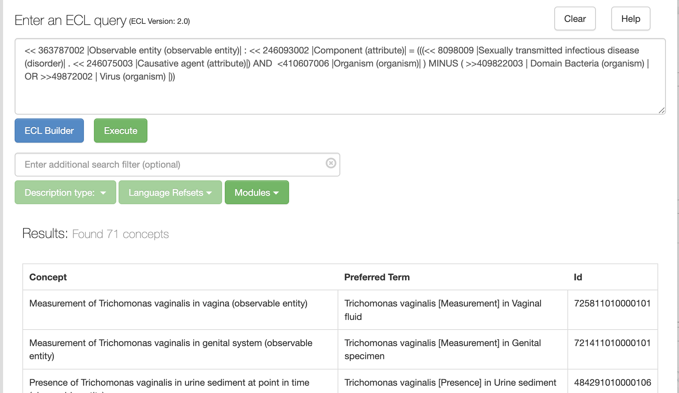
ECL Query for all tests for sexually transmitted infections

Slide 34
LOINC Mapping Use Cases
Stan Huff
Eza Hafeza
Pam Banning
© Regenstrief Institute, Inc.

Slide 35
The current situation
Most health data systems use their own internal codes
  EHRs, Lab Information Systems, Devices (ventilators,weight scales, BP measurement machines, etc.), Research databases, Analytical databases
  Systems from the same vendor often have differences in codes for implementations at different sites
  Different coding systems are used for billing, problem lists, drug trials, morbidity and mortality reporting
We want data to be reusable, and shared across systems, so mapping between code systems is a common need
© Regenstrief Institute, Inc.

Slide 36
Why Use Cases Matter in Mapping
The most demanding use case is when the data is used for direct patient care; little or no margin for error. (mapping local codes to standard codes)
Mapping for billing must be correct, or you may not get paid, or you may be guilty of fraud (mapping SNOMED to ICD, or LOINC to CPT)
Statistical analysis is a little less demanding because you can just analyze a bigger set of data until you get to the p-value you want (local codes to standard codes)
© Regenstrief Institute, Inc.

Slide 37
Mapping local codes to LOINC
Mapping local codes to LOINC is different than mapping local codes to ICD
  Because ICD is a classification, you are trying to put things into the right “bucket” – mapping to the closest code is good enough
Mapping local codes to LOINC
  The local codes must be mapped to the LOINC code with exactly the same meaning
  If there isn’t a LOINC code with the correct meaning, request a new LOINC code!
© Regenstrief Institute, Inc.

Slide 38
Options for Mapping
Do it yourself
Hire a professional mapper
Assign clinical experts to do the mapping
  They know their own organizational codes and policies
But… accurate mapping is really hard
  Unfamiliar tools and technology
  Complex structure and representation of standard codes
  Nuances in meaning
You have additional outside costs, but…
  They know the tools, and where the potholes are hidden
  Practice makes perfect
  Experts will probably do a better job than you, and much faster
© Regenstrief Institute, Inc.

Slide 39
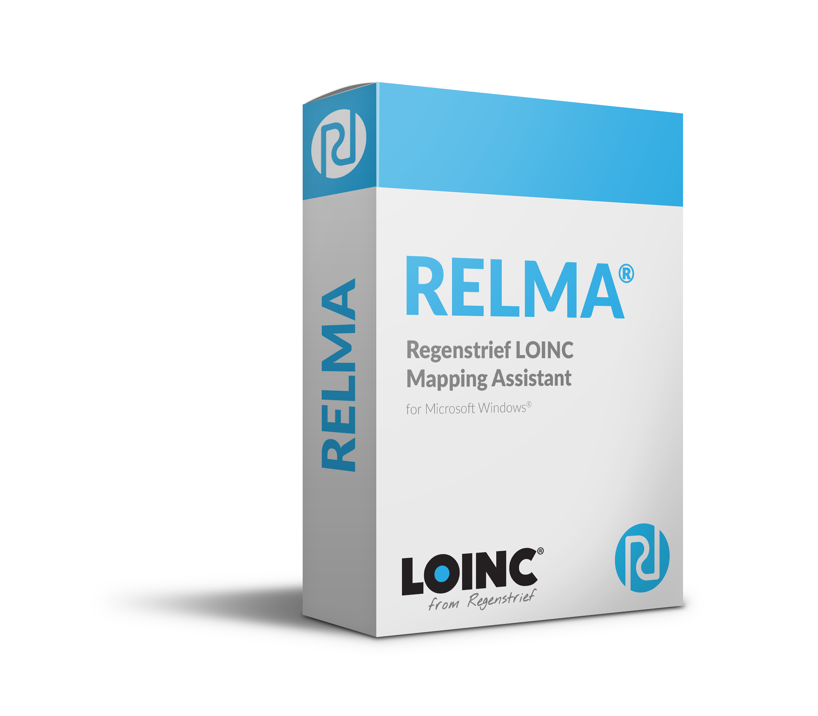
Mapping tools
RELMA – Regenstrief LOINC Mapping Assistant, is being retired
Commercial mapping tools
  Google for “commercial health terminology mapping tools”
  Returns a nice list of 6 of the most popular mapping tools
© Regenstrief Institute, Inc.

Slide 40
Semantic equivalence through mapping
Mapping local codes to standards: LOINC
Mapping for semantic equivalence
Local code and LOINC code must have the same meaning.
They do not need to have the same words, but they must have the same meaning.
When there is no LOINC code that means exactly the same thing as the local code…
Request a new LOINC code!
© Regenstrief Institute, Inc.
Notes:
When mapping local codes to standards, we are mapping for semantic equivalence.
This means the local code and the LOINC code must have the same meaning.
They do not need have the same words, but they need to have the same meaning,
If there is no LOINC code that has the exact same meaning as the local code, CLICK request a new LOINC code!

Slide 41
Why semantic equivalence matters in mapping
Mapping for semantic equivalence aligns data schemas to preserve meaning across systems.
When local data are mapped to standards such as LOINC, a shared understanding of data definitions emerges. This alignment enables accurate representation, consistent interpretation, and reliable data quality across systems."
© Regenstrief Institute, Inc.

Slide 42
Semantic equivalence through mapping:
Examples
Equivalence map
Local |  | LOINC
11111 | Blood sugar level | 2339-0 | Glucose [Mass/volume] in Blood
22222 | 24-hour urine sodium | 2956-1 | Sodium [Moles/time] in 24-hour Urine
33333 | Ankle reflex test | 32389-9 | Deep tendon reflex of Achilles
44444 | Throat swab, rapid Strep A screen | 78012-2 | Streptococcus pyogenes Ag [Presence] in Throat by Rapid immunoassay
© Regenstrief Institute, Inc.

Slide 43
Changing any attribute changes the LOINC term
© Regenstrief Institute, Inc.
Component | Glucose | Glucose
Property | mg/dL | mg/dL
Timing | PT | 24H
System | Urine | Urine
Scale | Qn | Qn
Method | <null> | <null>
LOINC term | 2350-7 | 21305-8
LOINC short name | Glucose Ur-mCnc | Glucose 24h Ur-mCnc

Slide 44
Common Mapping Errors
Incorrect scale (mapped qual instead of quant)
Incorrect property for units
Incorrect specimen
  Instances where there’s multi-fold differences
      Albumin by BCG or BCP – 5.5 g/L difference
      D-Dimer in FEU vs DDU – 2 fold
      LDH via substrate conversion
https://meridian.allenpress.com/aplm/article/144/5/586/427465/A-Survey-of-LOINC-Code-Selection-Practices-Among
https://doi.org/10.1093/jamia/ocac072
© Regenstrief Institute, Inc.

Slide 45
© Regenstrief Institute, Inc.

Slide 46

Thank you for coming!
© Regenstrief Institute, Inc.
Notes:
Thank you all for being with us today for LOINC Education Day.
We hope the sessions sparked new insights, gave you practical tools, and deepened your understanding of how LOINC can support your work.
It’s been wonderful to learn alongside such a diverse and engaged group.
Your participation, questions, and reflections are what make this day so valuable.
We look forward to carrying this momentum into the main LOINC Conference, which begins tomorrow.
I hope you’ll join us for the opening sessions as we continue to explore, share, and advance the use of data standards together.
On behalf of the entire team, thank you again for spending your day with us.
We’ll see you tomorrow at the opening of the LOINC Conference!

Slide 47

Reference Slides
© Regenstrief Institute, Inc.

Slide 48
Challenges to Semantic Interoperability

Slide 49
Organizational Challenges
CLINICAL ENGAGEMENT AND OWNERSHIP
    Expert clinicians must guide the content
    Governance and agreement on the consistent clinical models, profiles and services
TECHNICAL ADVANCES
    Data – common structure and language
    Services – SOA, FHIR, behavior/functionality
    Knowledge representation (Workflow, Decision support logic)
    API adoption
    Implementation
POLICY & LEGAL FRAMEWORK TO ENABLE INFORMATION AND KNOWLEDGE SHARING
    TEFCA
ALIGNMENT OF FINANCIAL INCENTIVES
    Value based payments, bundled payments, etc.
    Implementation of the agreed upon truly semantically interoperable data models, profiles, and services.
Notes:
Creating true open source interoperability is a big project, one we have studied and been a part of for years, and we’ve identified what it will take to create true interoperability. There are four major areas of focus. First, is engaging HC clinicians….
[In Technical Tools, select one or two specific bullets to explain. “Common language” and “decision support logic” seem like good examples that everyone could understand.]

Slide 50
Tasks for Clinical Experts
What data should be collected? (part of domain analysis)
  It will be different for different situations
How should the data be modelled?
  Two fields or one (the degree of pre and post coordination)
What does the data mean?
  How do we make computable definitions for diabetes mellitus, myocardial infarction, heart failure, chronic renal failure, etc.
24

Slide 51
Is Semantic Interoperability Even Possible?
Comprehensive semantic interoperability may require over 300,000+ FHIR profiles
    Really smart people have asked if we are “trying to boil the ocean?”
    “This could take decades, right?” We can’t wait that long!
Mitigating strategies that make it possible
    99.9% of the volume of available data is covered by a small fraction of the models
      50,000 Lab models to be comprehensive, only around 700 models cover 99.9% of volume
    We will do this in a step wise fashion, “One swimming pool at a time.”
      Do the most common and important domains first: lab, meds, vital signs, allergies/intolerances, conditions, procedures, documents, etc.
    You don’t have to be comprehensive of all of medicine to provide value
      The semantic standardization of lab data will have tremendous value by itself
    Pharmacy and financial data are close to semantic interoperability already
    Many of the most common models have already been created
      ~9,000 FHIR profiles are available as starting points in HL7 FHIR Implementation Guides
      ~7,500 models from previous work at Intermountain
    Work with app developers: make models on demand, just in time model creation
    Automation: Use ML/AI to generate draft versions of the models
Notes:
Creating true open source interoperability is a big project, one we have studied and been a part of for years, and we’ve identified what it will take to create true interoperability. There are four major areas of focus. First, is engaging HC clinicians….
[In Technical Tools, select one or two specific bullets to explain. “Common language” and “decision support logic” seem like good examples that everyone could understand.]

Slide 52
Goal: Find all LOINC observations where the component is an organism causing a STD (69)
ECL Query
<< 363787002 |Observable entity (observable entity)| : << 246093002 |Component (attribute)| = (((<< 8098009 |Sexually transmitted infectious disease (disorder)| . << 246075003 |Causative agent (attribute)|) AND <410607006 |Organism (organism)| ) MINUS ( >>409822003 | Domain Bacteria (organism) | OR >>49872002 | Virus (organism) |))

Slide 53
LOINC makes names for things in use
We try to only make names and codes for things that are real (exist in someone’s system)
We do not make all possible permutations that the six axes would allow (no blind cross products)
We don’t make codes that represent yes/no questions for every diagnosis in SNOMED CT
We do make names that allow both atomic (post coordinated) and molecular (pre coordinated) styles
Some people wish we would be more prescriptive!
We name everything, let others make usage rules
© Regenstrief Institute, Inc.

Slide 54
The LOINC code never stands alone…
The LOINC code alone never has all of the information that would make data instances semantically interoperable
You also need unit of measure, interpretation, priority, reference range, device/instrument/test kit, method, reagents, provenance data, …
© Regenstrief Institute, Inc.

Slide 55
Foundational assumptions
There should be one LOINC code for things that have the same clinical meaning, and conversely there are different codes for different meanings
  A sodium level is never used in place of a potassium level
  A urine sodium level is never used in place of a serum sodium level
  But are bilirubin levels done by different methods the same?
Conclusion: In some cases, “sameness” is in the eye of the beholder!
© Regenstrief Institute, Inc.
Notes:
Same clinical meaning details
The decision is easy for most things. Things that have a different component never have the same meaning. A sodium level is never used in place of a potassium level. A serum sodium never has the same clinical meaning as a urine sodium. Things that have different ”kind of properties” don’t have the same meaning.
However, do bilirubin measurements done by different methods have the same clinical meaning? Different use cases (patient care, research, public health) may have different views of what things are the “same.”

Slide 56
Foundational assumptions (part 2)
When possible, all available information should be sent in the message, and then let users determine what things are the “same” for their purposes
  Whenever possible, units of measure, method, device, anatomic location, reference range, etc. should be included in the message
We want to use LOINC codes to represent the data in patient data stores, not just in data exchange messages
  If we use LOINC codes in the primary data store, then we don’t need to translate and transform the data for secondary use
© Regenstrief Institute, Inc.
Notes:
Same clinical meaning details
The decision is easy for most things. Things that have a different component never have the same meaning. A sodium level is never used in place of a potassium level. A serum sodium never has the same clinical meaning as a urine sodium. Things that have different ”kind of properties” don’t have the same meaning.
However, do bilirubin measurements done by different methods have the same clinical meaning? Different use cases (patient care, research, public health) may have different views of what things are the “same.”

Slide 57
Things that are never part of the LOINC code
We do not make names that include information that already exists as part of the HL7 message structure
Names never contain
  Result status, order priority, units of measure
  Provenance information
    Ordering clinician
    Performing lab
    Specimen received time
    Identity of the observer
Examples
  Test priority is the message, so we don’t make LOINC codes that say, “Stat Serum Glucose.”
  The performing lab is in the message, so we don’t make a code like, “ACME Lab Serum Glucose.”
But there are supportive LOINCs if these are in separate OBX segments
© Regenstrief Institute, Inc.

Slide 58
Avoiding combinatorial explosion
Interface A (variable representation, rheumatologist view)
OBX|1|CE|4821-5^HLA-B27^LN|1|60373001^Detected^SNI|
(this approach causes creation of a LOINC code for each HLA type)
Interface B (value representation, transplant, or paternity view)
OBX|1|CE|4694-6^HLA-TYPE^LN|1|34453005^B27^SNI|
(this allows reuse of the HLA Type as the value of the result)
© Regenstrief Institute, Inc.

Slide 59
TECHNICAL APPROACH & MODELLING
JIM CASE, STAN HUFF, PETER WILLIAMS
Notes:
Modeling and content considerations
Tools, technical processes and design

Slide 60


Technical design and processes
Templates:
modelling and terming
LOINC concepts:
Google Sheet Output
  Classified terms
    Browser
Incorporates into
Process Document
Create
Incorporates into
Update
LOINC Part Details file from RII (LOINC semiannual release)
Update
Update
LOINC Part Map to SNOMED CT
Review and discuss issues:
Internally
With RII
Update
Update
Update
SNOMED CT monthly release

Slide 61
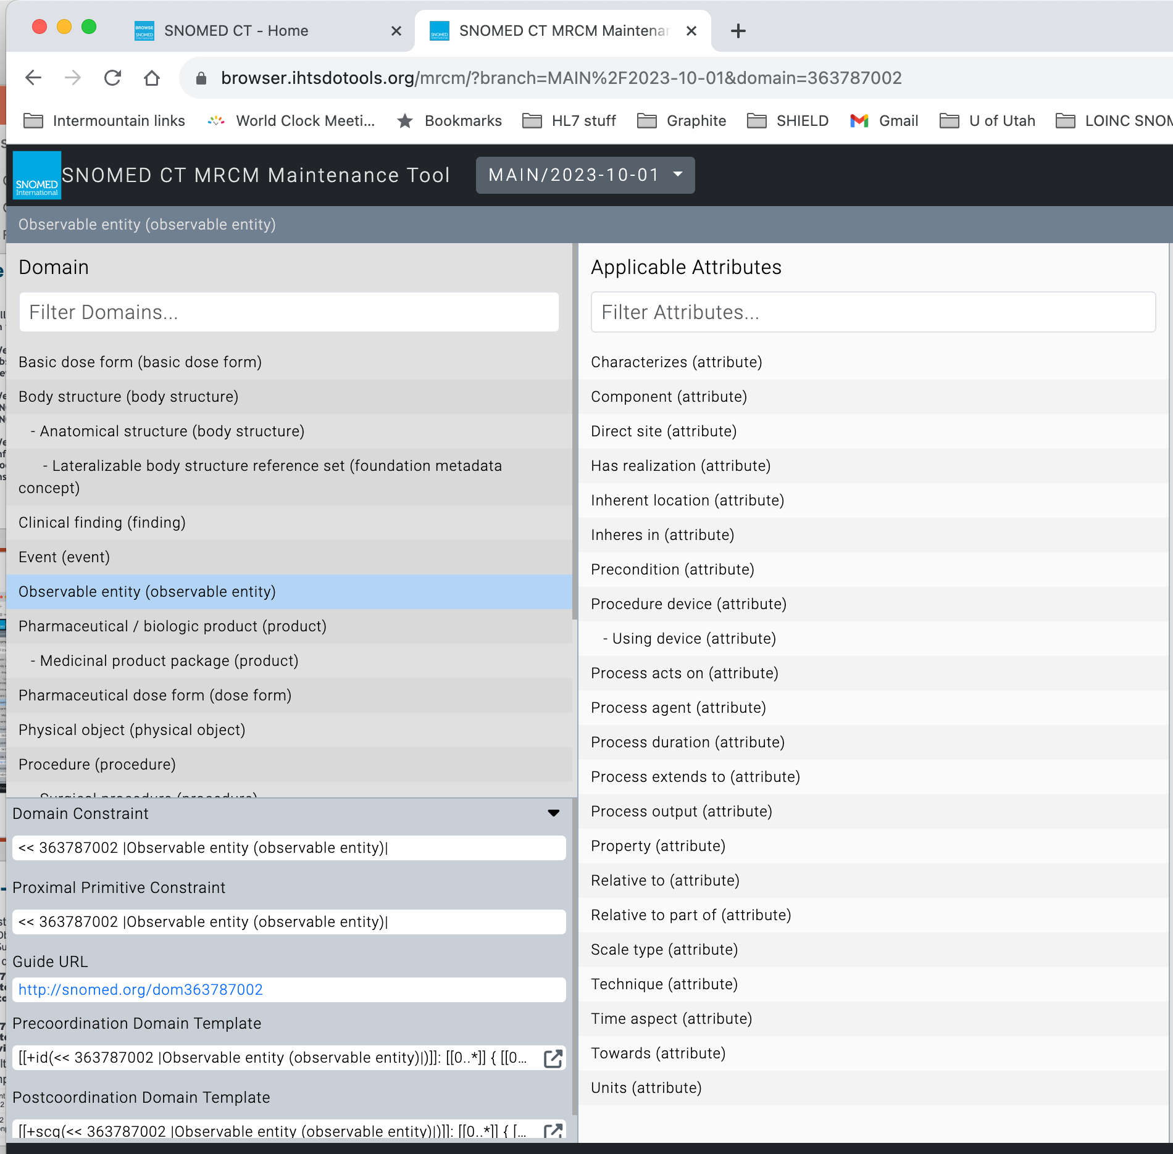
The MRCM – Observable entity

Slide 62
MRCM and LOINC Axes
LOINC Observables
[[+id(<< 363787002 |Observable entity (observable entity)|)]]:
…
[[0..1]] 246093002 |Component| = [[+id(<< 105590001 |Substance (substance)|
OR << 123037004 |Body structure (body structure)|
OR << 123038009 |Specimen (specimen)|
OR << 260787004 |Physical object (physical object)|
OR << 373873005 |Pharmaceutical / biologic product (product)|
OR << 410607006 |Organism (organism)|
OR << 419891008 |Record artifact (record artifact)|)]],
[[0..1]] 370130000 |Property| = [[+id(<< 118598001 |Property (qualifier value)|)]],
[[0..1]] 370134009 |Time aspect| = [[+id(<< 7389001 |Time frame (qualifier value)|)]],
{[0..1]] 704327008 |Direct site| = [[+id(<< 105590001 |Substance (substance)|
OR << 123037004 |Body structure (body structure)|
OR << 123038009 |Specimen (specimen)|
OR << 260787004 |Physical object (physical object)|
OR << 373873005 |Pharmaceutical / biologic product (product)|
OR << 410607006 |Organism (organism)|
OR << 419891008 |Record artifact (record artifact)|)]],
[[0..1]] 370132008 |Scale type| = [[+id(<< 117362005 |Nominal value (qualifier value)|
[[0..1]] 246501002 |Technique| = [[+id(<< 254291000 |Staging and scales (staging scale)|
OR << 117363000 |Ordinal value (qualifier value)|
OR << 117364006 |Narrative value (qualifier value)|
OR << 117365007 |Ordinal
Component
Property
Timing
System
Scale
Method

Slide 63
Improving Data Access Using Post Coordination in the Representation of Clinical Data
© Regenstrief Institute, Inc.

Slide 64

Acknolwedging the contributions of
Nathan Davis
Sr. Medical Informaticist
  Intermountain Health
  Graphite Health
M.S. Health Informatics, Perdue Global
B.S. Medical Laboratory Science, Weber State University
© Regenstrief Institute, Inc.

Slide 65
What is Pre and Post Coordination?
Pre Coordination
Post Coordination
  Observation
  code: 8335-2, Body Weight, Estimated
  value: 80.5 kg
  Observation
  code: 29463-7, Body Weight
  method: Estimated
  value: 80.5 kg
© Regenstrief Institute, Inc.

Slide 66
Current state of LOINC, an example
Systolic blood pressure - 122 active terms, 3 discouraged
8480-6 | Systolic blood pressure | 75997-7 | Systolic blood pressure by continuous non-invasive monitoring
8461-6 | Systolic blood pressure – supine | 8450-9 | Systolic blood pressure – expiration
8460-8 | Systolic blood pressure – standing | 8451-7 | Systolic blood pressure – inspiration
8459-0 | Systolic blood pressure – sitting | 87739-9 | Systolic blood pressure – w exercise
89268-7 | Systolic blood pressure – lying in L-lateral position | 89280-2 | Systolic blood pressure – during anesthesia
76215-3 | Invasive systolic blood pressure | 87741-5 | Systolic blood pressure – post exercise
76534-7 | Systolic blood pressure by noninvasive | 45372-0 | Blood pressure systolic and diastolic – post phlebotomy
8479-8 | Systolic blood pressure by palpation | 50403-5 | Blood pressure systolic and diastolic – before transfusion
8508-4 | Brachial artery systolic blood pressure | 50402-7 | Blood pressure systolic and diastolic – after transfusion
8510-0 | Femoral artery systolic blood pressure
© Regenstrief Institute, Inc.

Slide 67
Systolic BP Example
{BP Method}
8480-6 | Intravascular systolic | Pres | Pt | Arterial system | Qn
76215-3 | Intravascular systolic | Pres | Pt | Arterial system | Qn | Invasive
76534-7 | Intravascular systolic | Pres | Pt | Arterial system | Qn | Noninvasive
8479-8 | Intravascular systolic | Pres | Pt | Arterial system | Qn | Palpation
75997-7 | Intravascular systolic | Pres | Pt | Arterial system | Qn | CNAP
8459-0 | Intravascular systolic^sitting | Pres | Pt | Arterial system | Qn
8460-8 | Intravascular systolic^standing | Pres | Pt | Arterial system | Qn
Method {BP Method}
Invasive
Noninvasive
Palpation
CNAP
Patient Position {BP Pt Position}
Sitting
Standing
© Regenstrief Institute, Inc.

Slide 68
Systolic BP Instance Data
Option #1
Option #2 Preferred
  Observation
  code: 8459-0, Systolic BP Sitting
  value: 120 mmHg
  Observation
  code: 8480-6, Systolic BP
  original/pre-coordinated: 8459-0
  value: 120 mmHg
  method: Non-invasive (qualifier)
  (SNOMED CT# 22762002)
  bodyPosition: Sitting position (finding)
  (SNOMED CT#33586001)
Attributes – Standard LOINC code
Values from a value set
© Regenstrief Institute, Inc.

Slide 69
Neisseria gonorrhoeae DNA example
New | Neisseria gonorrhoeae DNA | PrThr | Pt | {GC Specimen} | Ord | {GC DNA method}
24111-7 | Neisseria gonorrhoeae DNA | PrThr | Pt | XXX | Ord | Probe.amp.tar
43403-5 | Neisseria gonorrhoeae DNA | PrThr | Pt | XXX | Ord | Probe.amp.sig
35735-0 | Neisseria gonorrhoeae DNA | PrThr | Pt | Cnjt | Ord | Probe.amp.tar
21414-8 | Neisseria gonorrhoeae DNA | PrThr | Pt | Cvm | Ord | Probe.amp.tar
96599-6 | Neisseria gonorrhoeae DNA | PrThr | Pt | Cvx | Ord | Probe.amp.tar
47387-6 | Neisseria gonorrhoeae DNA | PrThr | Pt | Genital | Ord | Probe.amp.tar
57180-2 | Neisseria gonorrhoeae DNA | PrThr | Pt | Nph | Ord | Probe.amp.tar
88225-8 | Neisseria gonorrhoeae DNA | PrThr | Pt | Thrt | Ord | Probe.amp.tar
21415-5 | Neisseria gonorrhoeae DNA | PrThr | Pt | Urethra | Ord | Probe.amp.tar
21416-3 | Neisseria gonorrhoeae DNA | PrThr | Pt | Urine | Ord | Probe.amp.tar
32705-6 | Neisseria gonorrhoeae DNA | PrThr | Pt | Vag | Ord | Probe.amp.tar
© Regenstrief Institute, Inc.
Notes:
Note that the whole proposed solution can’t be represented in the six axis parts of the model
Proposed rule: only represent the value sets that are part of the six axes as the definitional part of the LOINC code?

Slide 70
Example instance data for Neisseria gonorrhoeae DNA
Option #1
Option #2 - Preferred
  Observation
  code: 47387-6 Neisseria gonorrhoeae DNA [Presence] in Genital specimen by NAA with probe detection
  value: Positive
  Observation
  code: New, Neisseria gonorrhoeae DNA [Presence]
  original/pre-coordinated: 47387-6
  system (66746-9): Genital specimen
  (SCTID: 119344008)
  method: (85069-3): Probe.amp.tar
  (SCTID: 702675006)
  value: Positive
© Regenstrief Institute, Inc.

Slide 71
Constrained model for Neisseria gonorrhoeae DNA by Molecular genetics method
LOINC code = 104765-3 (required)
original LOINC code (from value set of Neisseria gonorrhoeae DNA codes) (optional)
value [coded: Positive, Negative] (required)
unit of measure, (not used for this analyte/test)
threshold/cutoff, (not used for this analyte/test)
interpretation, [coded: Normal, Abnormal] (optional)
reference range, (not used for this analyte/test)
method (from value set of Neisseria gonorrhoeae DNA test methods) (optional)
screen/confirm, (not used for this analyte/test)
device (UDI), (optional)
reagent, (required)
specimen (from value set of Neisseria gonorrhoeae DNA specific specimens) (required)
provenance info
collection date/time
specimen in lab date/time
performer
testing laboratory
© Regenstrief Institute, Inc.

Slide 72
Benefits of a more post coordinated approach
Data is easier to query for all bacterial cultures when using the preferred model
  Subsumption logic – querying for one LOINC code (the new code) retrieves all N. gonorrhoeae DNA tests, the specializations are subsumed in the LOINC Ontology
  When you want a specific subtype, you specify LOINC code = (the new code) AND Specimen (66746-9): Genital (SCTID: 119344008)
People using the data can decide what subtypes are correct for their use case
It is easier to select the right primary LOINC code
  Fewer highly pre-coordinated LOINC codes to choose from
It is easier to maintain queries and CDS algorithms in software applications
  Adding values to a value set is easier than accommodating a new pre-coordinated code
© Regenstrief Institute, Inc.

Slide 73

Interoperability Today
Legend:
shape = structure
color = terminology
Real World
Digital
World
Data Sharing and Re-use
Application
© Regenstrief Institute, Inc.

Slide 74
Interoperability in the Future
Real World
Digital
World
Data Sharing and Re-use
(no translation, just use it!)
Application
Legend:
shape = structure
color = terminology
© Regenstrief Institute, Inc.

Slide 75
Founding Lab LOINC Committee Members
Ray Aller
John Baenziger
Pam Banning
Jim Bristol
Tom Burgess
Jim Case
Linda Charles
Jim Cimino
Diane Dwyer
Arden Forrey
Andy Gajda
Norbert Goldfield
Brian Griffin
Ed Hazell
Gil Hill
Stan Huff
Kathy Kammerer
Dennis Leavelle
Diane Leland
Pat Maloney
Doug Martin
Clem McDonald
Bill Meilahn
Frank Stalling
John Stelling
Bill Thurston
Dan Yokota
© Regenstrief Institute, Inc.

Slide 76
Founding Clinical LOINC Members
James Barthel
Dean Bidgood
Bruce Bray
Bill Francis
Alan Golichowski
Karl Hammermeister
Anders Thurin
Barry Gordon
Warren Williams
James Campbell
Jim Cimino
Sue Bakken
Pat Wilson
Stan Huff
Doug Martin
Clem McDonald
Dan Pollock
Angelo Rossi Mori
Susan Matney
Jeff Suico
WayneTracy
Pavla Frazier
Lee Min Lau
Shaun Shakib
Bill Karitis
Thomas White
Steven Steindel
© Regenstrief Institute, Inc.

Slide 77
Literature References
McDonald CJ, Huff SM, etal. LOINC® a universal standard for identifying laboratory observations – a 5-year Update. Clinical Chemistry, 2003 (Accepted)
Huff SM, Rocha RA, McDonald CJ, De Moor GJE, etal. Development of the LOINC (Logical Observation Identifier Names and Codes) Vocabulary. Journal of American Medical Informatics Association, 1998, 5:276-292.
Dolin RH, Huff SM, Rocha RA, Spackman KA, Campbell, KE. Evaluation of a “Lexically Assign, Logically Refine”Strategy for Semi-Automated Integration of Overlapping Terminologies. Journal of American Medical Informatics Association, 1998, 5:203-213.
Forrey AW, McDonald CJ, DeMoor G, Huff SM , Leavelle D, Leland Fiers DT, Charles L, Griffin B, Stalling F, Tullis A, Hutchins K, Baenziger J. Logical Observation Identifier Names and Codes (LOINC) Database: A public use set of codes and names for electronic reporting of clinical laboratory test results. Clinical Chemistry, 1995.
© Regenstrief Institute, Inc.

Slide 78
Examples of fully specified LOINC names
Sodium :SCnc :Pt :Ser :Qn
Sodium :Scnc :Pt :Ur :Qn
Sodium :SRat :24H:Ur :Qn
Gentamicin^trough :MCnc :Pt :Ser :Qn
Calcium.free :SCnc :Pt :Ser :Qn
Protein.albumin :MCnc :Pt :Syn :Qn :Electropheresis
Ejection fraction :VFr :Pt :Cardiac ventricular.left :Qn :Angiogram
History of present illness :Find :Pt :^Patient :Nar :Reported
Physical findings :Find :Pt :Ear :Nom :Observed
© Regenstrief Institute, Inc.

