Slide 1
Clinical Information Models and FHIR: Designing a Single Sustainable Implementation Guide
Taipei Medical University Hospital
March 25, 2026
Stanley M. Huff, MD
Professor (Clinical) Department of Biomedical Informatics, University of Utah School of Medicine
Chair, Clinical LOINC Committee
Notes:
Welcome Back
We hope you enjoyed that excellent and thought provoking keynote by Dr. Ehrenfeld that definitely left us with some important call to actions.
And we hope you have had some time during the break for networking.
Now we would like to move to the next part of the program and talk about our vision for LOINC.
Earlier in the year, we celebrated LOINC’s 30th anniversary which is a tremendous milestone of 30 years of working together to improve health data and interoperability for better care and better health.
That was a time to reminisce, now we would like to take some time to look forward and talk about where LOINC is going next.
I am going to talk about where we are headed strategically and then Stan Huff, who Chairs the LOINC Clinical Committee will drill down a bit more and talk about where we are going with LOINC in terms of its content and concept model and the changes we are proposing to LOINC so that it continues to grow and evolve to meet the needs or interoperability, particularly semantic interoperability.

Slide 2

Topics
Concept models and information models
Overlap of concept models and information models
Specialization of information models
The open semantic interoperability ecosystem
Creating information models and generating FHIR profiles
© Regenstrief Institute, Inc.

Slide 3
Concept Models and Information Models

Slide 4
Definitions for this session
Concept models
Models used to define how to organize words and terms (parts) to create formal codes/concepts (LOINC, SNOMED, RxNorm, …) concepts
Information models
Models used to guide creation of instances of data about things in the real world

Slide 5
Examples of concept models:
The Classic Six Axis LOINC Model
<component> : <property> : <timing>
<system> : <scale> : <method>
The SNOMED CT Machine Readable Concept Model

Slide 6
MRCM and LOINC Axes
[[+id(<< 363787002 |Observable entity (observable entity)|)]]:
…
[[0..1]] 246093002 |Component| = [[+id(<< 105590001 |Substance (substance)|
OR << 123037004 |Body structure (body structure)|
OR << 123038009 |Specimen (specimen)|
OR << 260787004 |Physical object (physical object)|
OR << 373873005 |Pharmaceutical / biologic product (product)|
OR << 410607006 |Organism (organism)|
OR << 419891008 |Record artifact (record artifact)|)]],
[[0..1]] 370130000 |Property| = [[+id(<< 118598001 |Property (qualifier value)|)]],
[[0..1]] 370134009 |Time aspect| = [[+id(<< 7389001 |Time frame (qualifier value)|)]],
{[0..1]] 704327008 |Direct site| = [[+id(<< 105590001 |Substance (substance)|
OR << 123037004 |Body structure (body structure)|
OR << 123038009 |Specimen (specimen)|
OR << 260787004 |Physical object (physical object)|
OR << 373873005 |Pharmaceutical / biologic product (product)|
OR << 410607006 |Organism (organism)|
OR << 419891008 |Record artifact (record artifact)|)]],
[[0..1]] 370132008 |Scale type| = [[+id(<< 117362005 |Nominal value (qualifier value)|
[[0..1]] 246501002 |Technique| = [[+id(<< 254291000 |Staging and scales (staging scale)|
OR << 117363000 |Ordinal value (qualifier value)|
OR << 117364006 |Narrative value (qualifier value)|
OR << 117365007 |Ordinal
LOINC Observables
Component
Property
Timing
System
Scale
Method

Slide 7
Example information model for quantitative lab
Quantitative Lab Result
patient identity
code {from LOINC},
value,
unit of measure,
threshold/cutoff,
interpretation,
reference range,
method,
screen/confirm
device,
reagent,
provenance information
…,
The information model :
Shows the primary LOINC code …
In the context of all other attributes that would/could be important for understanding the complete meaning of the primary data

Slide 8
Overlap of Concept Models and Information Models

Slide 9
Overlap of data elements
Information Model
Concept Model
Patient ID
Location of testing
Specimen Source
Observation code
Ordering clinician
Result status
Interpretation
Setting
Specimen collection time
Comment
Units of measure
Method
Device
Threshold
Pre-condition
Body location
Component
Property
Timing
Scale
Specimen Type

Slide 10
Example result for Neisseria gonorrhoeae DNA
Option #1 – pre coordinated
Option #2 – post coordinated
  Observation
  code: New, Neisseria gonorrhoeae DNA [Presence]
  specimen: (66746-9): Genital specimen
  (SCTID: 119344008)
  method: (85069-3): Probe.amp.tar
  (SCTID: 702675006)
  value: Positive
  Observation
  code: 47387-6 Neisseria gonorrhoeae DNA [Presence] in Genital specimen by NAA with probe detection
  value: Positive
Specimen and method are included in the concept model
Specimen and method are included in the information model

Slide 11
Where we are (from a modeling perspective)
The Situation
  Creators of codes (Regenstrief, SNOMED International, ..) have a choice to represent particular attributes of real-world data as part of the concept model, or part of the information model. That is, a data element can be part of the meaning of a single code, or the data element can exist as an independent element in data instances.
The Challenge
  How much meaning should be in the LOINC code versus important facts that are represented as other fields in databases or data exchange messages?

Slide 12
Assertion
We need information models to:
  Establish the meaning of data and information used in medical reasoning and diagnosis
  Define the boundary between concept models and information models
  To establish a single preferred logical representation for each type of detailed health data and information
  Enable generation of technology specific profiles for data exchange standards
  Create maps between the preferred representation and other allowed representations

Slide 13
Specialization of Information Models

Slide 14
Example comprehensive model for laboratory data
Laboratory Observation
patient ID, (required)
code: from LOINC (required)
original code: from LOINC
value (required) (Qn, SemiQn, Ord, Nom, Nar)
unit of measure
interpretation (optional),
reference range (optional),
method (optional),
screen/confirm (optional),
device (UDI) (optional),
reagent (optional),
specimen type (optional),
specimen source (optional),
provenance information (required)
collection date/time
specimen in lab date/time
performer
testing laboratory
Inclusion of all attributes that anyone needs
No 80/20 rule!

Slide 15
Constrained model for Neisseria gonorrhoeae DNA result
Neisseria gonorrhoeae DNA Observation
patient ID
code = 104765-3 (required)
original LOINC code (from value set of Neisseria gonorrhoeae DNA codes) (optional)
value [coded: Positive, Negative] (required)
unit of measure, (not used for this analyte/test)
threshold/cutoff, (not used for this analyte/test)
interpretation, [coded: Normal, Abnormal] (optional)
reference range, (not used for this analyte/test)
method (from value set of Neisseria gonorrhoeae DNA test methods) (required)
screen/confirm, (not used for this analyte/test)
device (UDI), (optional)
reagent, (optional)
specimen (from value set of Neisseria gonorrhoeae DNA specific specimens) (required)
provenance information (required)
collection date/time
specimen in lab date/time
performer
testing laboratory

Slide 16
Constrained model for Neisseria gonorrhoeae DNA result
Neisseria gonorrhoeae DNA Observation
patient ID
code = 104765-3 (required)
original LOINC code (from value set of Neisseria gonorrhoeae DNA codes) (optional)
value [coded: Positive, Negative] (required)
interpretation, [coded: Normal, Abnormal] (optional)
method (from value set of Neisseria gonorrhoeae DNA test methods) (optional)
device (UDI), (optional)
reagent, (optional)
specimen (from value set of Neisseria gonorrhoeae DNA specific specimens) (required)
provenance information (required)
collection date/time
specimen in lab date/time
performer
testing laboratory

Slide 17
Inheritance and Specialization of Information Models
Observation
Major Classes
Lab Obs
Patient Obs
Family Hx Obs
Models and Profiles
Final Structure
Qn Lab Obs
Titer Lab Obs
Qual Lab Obs
Leaf Nodes
Hematocrit
Serum Glucose
Urine Sodium
Leaf nodes have Invariant structure – only LOINC codes, units of measure, value sets, …, are changing.

Slide 18
The Open Semantic Interoperability Ecosystem

Slide 19



Open Interoperability Ecosystem
The role of information models in data standardization
STANDARDIZATION & POLICY
DEVELOPMENT LAB (sandbox)
MARKETPLACE
MODEL DEV. SERVICES
Open
STANDARD
ENGAGEMENT SERVICES
DEVELOPMENT ENVIRONMENT
Compliance CERTIFICATION
CERTIFIED
APPLICATIONS
INTEROPERABILITY PLATFORM
APPLICATION PLATFORM
Patient Data
Sources
STANDARDIZATION
SERVICE
DATA MANAGEMENT
SERVICE
FHIR
INTERNAL APPLICATIONS
PURCHASED APPLICATIONS
Could be
a PHR
Includes Generative and
Agentic AI
SYSTEM FIREWALL
SHARED TRUST ENVIRONMENT

Slide 20
Too many ways to say the same thing!
Option #1a
Option #2a (Preferred)
  Observation
  code: 69000-8 Heart rate –sitting
  value: 72 {beats}/min
  Observation
  code: 8867-4, HR (was 69000-8)
  value: 72 {beats}/min
  bodyPosition: Sitting body position (finding)
  (SNOMED CT #33586001)
Option #1b
Option #2b (Preferred)
  Observation
  code: 68999-2 Heart rate – supine
  value: 72 {beats}/min
  Observation
  code: 8867-4, HR (was 68999-2)
  value: 72 {beats}/min
  bodyPosition: Supine body position (finding)
  (SNOMED CT #40199007)

Slide 21
To enable semantic interoperability, we need to:
Define a single preferred logical representation for each data element
Create maps to translate between valid alternative representations of data and information
  Different use cases sometimes require alternative allowed representations

Slide 22
Formal languages for representing information models
Clinical Element Modeling Language (CEML)
Abstract Syntax Notation 1 (ASN1)
Archetype Definition Language (ADL)
SNOMED Expression Language
Unified Modeling Language (UML)
HL7 FHIR Structure Definition
Extensible Markup Language Metadata Interchange (XMI)

Slide 23
Creating Information Models and Generating FHIR Profiles

Slide 24
Model Development Workflow
Narrative Health Records
Structured Health Records
Journal Articles
Textbooks
Existing Models
Terminology
Server
Draft 2
Value Set Creation and
Terminology
Mapping
NLP
LLMs, Generative AI
Silver
Draft Models
Model
Library
Human
Review
(Minimize!)
Bronze
Gold

Slide 25
Development of Technology Specific Artifacts
Transformation
Knowledgebase
HL7 FHIR
Profiles
HL7 V2.X
IGs
Model
Library
Model
Transformation Widget
C-CDA
Templates
OMOP
Format
Others
Notes:
Defining the structural knowledge of medical data is the hard job. It is relatively easy to create cross compilers that create the different exchange syntaxes.

Slide 26
Translation maps for isosemantic models

Slide 27
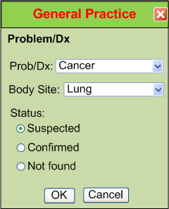
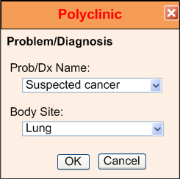
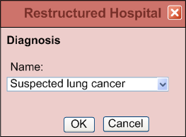
Different approaches for representing isosemantic data
(from Dr.Linda Bird)
“Suspected Lung Cancer”

Slide 28
Example instance data for “Suspected Lung Cancer”
Option #1
Option #2 - Preferred
  Condition
  code: Suspected lung cancer
  (SCT 162573006)
  Condition
  code: Cancer (SCT 363346000)
  system: Lung (SCT 39607008)
  certainty: Suspected
  (SCT 415684004)

Slide 29
Process for creating isosemantic maps
Pre-coordinated disease model
SNOMED CT
Lookup
  Disease: Suspected lung cancer
  (SCT 162573006)
Suspected lung cancer
Associated finding → Lung Cancer
Finding context → Suspected
Post-coordinated disease model
  Disease: Cancer (SCT 363346000)
  Location: Lung (SCT 39607008)
  Context: Suspected (SCT 415684004)
Finding site → Lung
Associated morphology → Cancer
Computable map of pre to post coordinated data
IF (Pre-coordinated_disease_model.Disease == 162573006) THEN {
Post-coordinated_disease_model.Disease = 363346000;
Post-coordinated_disease_model.Location = 39607008;
Post-coordinated_disease_model.Context = 415684004;}
Notes:
This method can only be used for concepts where the relationships exist in current medical ontologies

Slide 30
Isosemantic map knowledgebase
Pre-coord
code
Information model
Post-coord elements
Post-coord codes
code: Suspected Lung Cancer | 162573006 (SCT) | Cancer | 363346000 (SCT)
 |  | Lung | 39607008 (SCT)
 |  | Suspected | 415684004 (SCT)
code: Lung Cancer certainty: Suspected | 363358000 (SCT) 415684004 (SCT) | Cancer | 363346000 (SCT)
 |  | Lung | 39607008 (SCT)
 |  | Suspected | 415684004 (SCT)

Slide 31
Development of Technology Specific Artifacts
Data Transformation
Knowledgebase
Patient data output
Patient data input
  FHIR Condition
  patient: Doe, John
  code: Cancer (SCT 363346000)
  system: : Lung (SCT 39607008)
  certainty: Suspected
  (SCT 415684004)
  FHIR Condition
  patient: Doe, John
  code: Suspected lung cancer
  (SCT 162573006)
Data
Transform Widget
Notes:
Defining the structural knowledge of medical data is the hard job. It is relatively easy to create cross compilers that create the different exchange syntaxes.

Slide 32

Thank you for coming!
© Regenstrief Institute, Inc.
Notes:
Thank you all for being with us today for LOINC Education Day.
We hope the sessions sparked new insights, gave you practical tools, and deepened your understanding of how LOINC can support your work.
It’s been wonderful to learn alongside such a diverse and engaged group.
Your participation, questions, and reflections are what make this day so valuable.
We look forward to carrying this momentum into the main LOINC Conference, which begins tomorrow.
I hope you’ll join us for the opening sessions as we continue to explore, share, and advance the use of data standards together.
On behalf of the entire team, thank you again for spending your day with us.
We’ll see you tomorrow at the opening of the LOINC Conference!

Slide 33

Reference Slides
© Regenstrief Institute, Inc.

Slide 34
Clinical Element Modeling Language (CEML)

Slide 35
Basic elements of the core model
Type - The name of a particular model
Key - Links the model to a concept in an external coded terminology.
Value Choice - Possible ways to convey the model’s value.
Notes:
Do not want to store LOINC, SNOMED code directly by design. We link to external coded terminology.
1. Impossible to correct errors made in standard terminology, I.e. SNOMED, unless change database. If use mapping, then can just change the mapping to correct the error.
2. Standard terminology makes mistakes.

Slide 36
Value Choice
Data - Value conveyed as an HL7 version 3 data type
Items - Value conveyed by multiple Clinical Elements collectively

Slide 37
A Simple Laboratory Observation CEM
SerumSodiumMeas (model name)
SerumSodium (LOINC code)

Slide 38
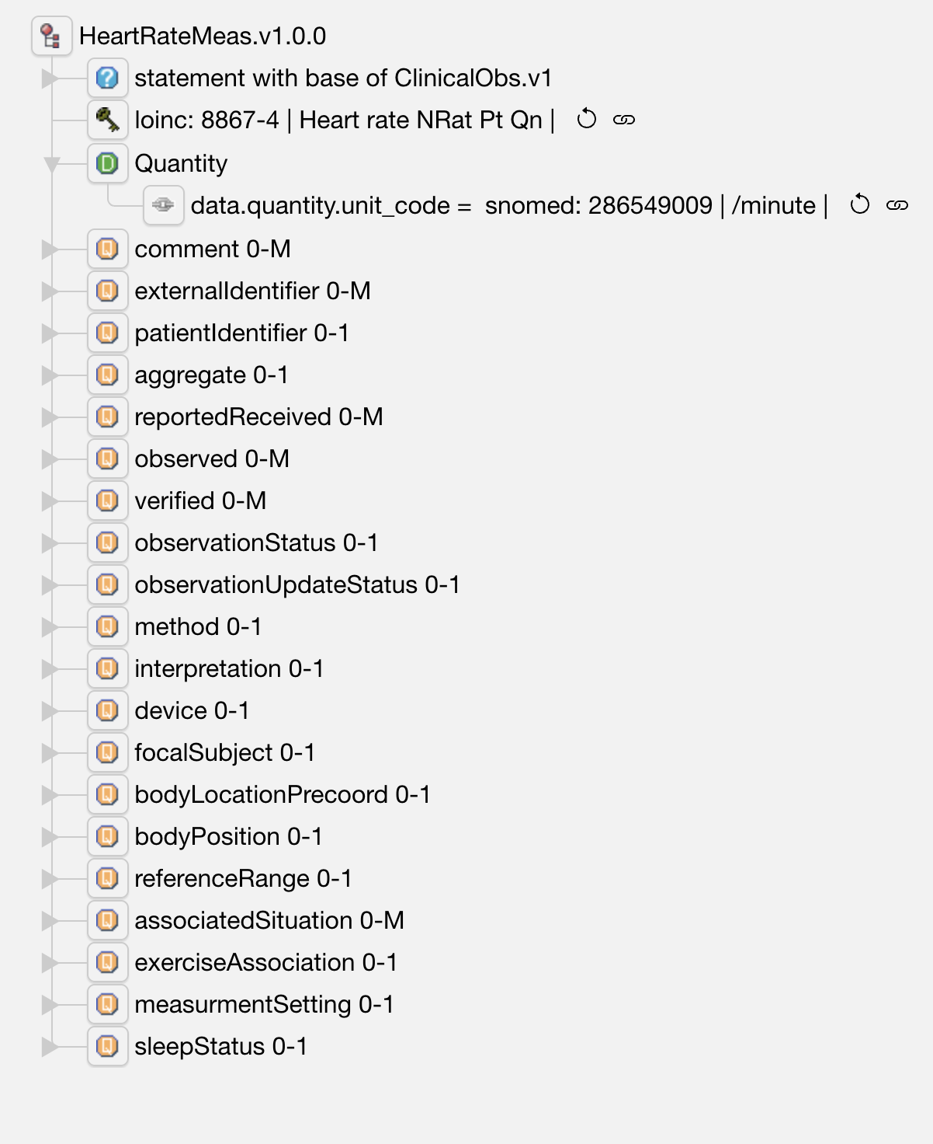
Heart rate Information Model (a CEM/CDE)

Slide 39
CEML Model for Heart Rate
cem HeartRateMeas.v1.0.0
kind statement
base ClinicalObs.v1
key HeartRate_CODE
data Quantity
elm bodyLocationPrecoord: BodyLocationPrecoord.v1
use qualifier
card 0-1
elm bodyPosition: BodyPosition.v1
use qualifier
…

Slide 40
Improving Data Access Using Post Coordination in the Representation of Clinical Data
© Regenstrief Institute, Inc.

Slide 41

Acknolwedging the contributions of
Nathan Davis
Sr. Medical Informaticist
  Intermountain Health
  Graphite Health
M.S. Health Informatics, Perdue Global
B.S. Medical Laboratory Science, Weber State University
© Regenstrief Institute, Inc.

Slide 42
What is Pre and Post Coordination?
Pre Coordination
Post Coordination
  Observation
  code: 8335-2, Body Weight, Estimated
  value: 80.5 kg
  Observation
  code: 29463-7, Body Weight
  method: Estimated
  value: 80.5 kg
© Regenstrief Institute, Inc.

Slide 43
Avoiding combinatorial explosion
Interface A (variable representation, rheumatologist view)
OBX|1|CE|4821-5^HLA-B27^LN|1|60373001^Detected^SNI|
(this approach causes creation of a LOINC code for each HLA type)
Interface B (value representation, transplant, or paternity view)
OBX|1|CE|4694-6^HLA-TYPE^LN|1|34453005^B27^SNI|
(this allows reuse of the HLA Type as the value of the result)
© Regenstrief Institute, Inc.

Slide 44
Foundational assumptions (reminder)
There should be one LOINC code for things that have the same clinical meaning, different codes for different meanings
  A sodium level is never used in place of a potassium level
  A urine sodium level is never used in place of a serum sodium level
  Are bilirubin levels done by different methods the same?
Conclusion: “Sameness” is in the eye of the beholder!
The LOINC code alone never has all of the information that would make data instances semantically interoperable
  You also need unit of measure, interpretation, priority, reference range, device/instrument/test kit, method, reagents, provenance data, …
© Regenstrief Institute, Inc.
Notes:
Same clinical meaning details
The decision is easy for most things. Things that have a different component never have the same meaning. A sodium level is never used in place of a potassium level. A serum sodium never has the same clinical meaning as a urine sodium. Things that have different ”kind of properties” don’t have the same meaning.
However, do bilirubin measurements done by different methods have the same clinical meaning? Different use cases (patient care, research, public health) may have different views of what things are the “same.”

Slide 45
Foundational assumptions (reminder)
When possible, all available information should be sent in the message, and then let users determine what things are the “same” for their purposes
We want to use LOINC codes to represent the data in patient data stores, not just in data exchange messages
© Regenstrief Institute, Inc.
Notes:
Same clinical meaning details
The decision is easy for most things. Things that have a different component never have the same meaning. A sodium level is never used in place of a potassium level. A serum sodium never has the same clinical meaning as a urine sodium. Things that have different ”kind of properties” don’t have the same meaning.
However, do bilirubin measurements done by different methods have the same clinical meaning? Different use cases (patient care, research, public health) may have different views of what things are the “same.”

Slide 46
Current state of LOINC, an example
Systolic blood pressure - 122 active terms, 3 discouraged
8480-6 | Systolic blood pressure | 75997-7 | Systolic blood pressure by continuous non-invasive monitoring
8461-6 | Systolic blood pressure – supine | 8450-9 | Systolic blood pressure – expiration
8460-8 | Systolic blood pressure – standing | 8451-7 | Systolic blood pressure – inspiration
8459-0 | Systolic blood pressure – sitting | 87739-9 | Systolic blood pressure – w exercise
89268-7 | Systolic blood pressure – lying in L-lateral position | 89280-2 | Systolic blood pressure – during anesthesia
76215-3 | Invasive systolic blood pressure | 87741-5 | Systolic blood pressure – post exercise
76534-7 | Systolic blood pressure by noninvasive | 45372-0 | Blood pressure systolic and diastolic – post phlebotomy
8479-8 | Systolic blood pressure by palpation | 50403-5 | Blood pressure systolic and diastolic – before transfusion
8508-4 | Brachial artery systolic blood pressure | 50402-7 | Blood pressure systolic and diastolic – after transfusion
8510-0 | Femoral artery systolic blood pressure
© Regenstrief Institute, Inc.

Slide 47
Systolic BP Example
{BP Method}
8480-6 | Intravascular systolic | Pres | Pt | Arterial system | Qn
76215-3 | Intravascular systolic | Pres | Pt | Arterial system | Qn | Invasive
76534-7 | Intravascular systolic | Pres | Pt | Arterial system | Qn | Noninvasive
8479-8 | Intravascular systolic | Pres | Pt | Arterial system | Qn | Palpation
75997-7 | Intravascular systolic | Pres | Pt | Arterial system | Qn | CNAP
8459-0 | Intravascular systolic^sitting | Pres | Pt | Arterial system | Qn
8460-8 | Intravascular systolic^standing | Pres | Pt | Arterial system | Qn
Method {BP Method}
Invasive
Noninvasive
Palpation
CNAP
Patient Position {BP Pt Position}
Sitting
Standing
© Regenstrief Institute, Inc.

Slide 48
Systolic BP Instance Data
Option #1
Option #2 Preferred
  Observation
  code: 8459-0, Systolic BP Sitting
  value: 120 mmHg
  Observation
  code: 8480-6, Systolic BP
  original/pre-coordinated: 8459-0
  value: 120 mmHg
  method: Non-invasive (qualifier)
  (SNOMED CT# 22762002)
  bodyPosition: Sitting position (finding)
  (SNOMED CT#33586001)
Attributes – Standard LOINC code
Values from a value set
© Regenstrief Institute, Inc.

Slide 49
Neisseria gonorrhoeae DNA example
New | Neisseria gonorrhoeae DNA | PrThr | Pt | {GC Specimen} | Ord | {GC DNA method}
24111-7 | Neisseria gonorrhoeae DNA | PrThr | Pt | XXX | Ord | Probe.amp.tar
43403-5 | Neisseria gonorrhoeae DNA | PrThr | Pt | XXX | Ord | Probe.amp.sig
35735-0 | Neisseria gonorrhoeae DNA | PrThr | Pt | Cnjt | Ord | Probe.amp.tar
21414-8 | Neisseria gonorrhoeae DNA | PrThr | Pt | Cvm | Ord | Probe.amp.tar
96599-6 | Neisseria gonorrhoeae DNA | PrThr | Pt | Cvx | Ord | Probe.amp.tar
47387-6 | Neisseria gonorrhoeae DNA | PrThr | Pt | Genital | Ord | Probe.amp.tar
57180-2 | Neisseria gonorrhoeae DNA | PrThr | Pt | Nph | Ord | Probe.amp.tar
88225-8 | Neisseria gonorrhoeae DNA | PrThr | Pt | Thrt | Ord | Probe.amp.tar
21415-5 | Neisseria gonorrhoeae DNA | PrThr | Pt | Urethra | Ord | Probe.amp.tar
21416-3 | Neisseria gonorrhoeae DNA | PrThr | Pt | Urine | Ord | Probe.amp.tar
32705-6 | Neisseria gonorrhoeae DNA | PrThr | Pt | Vag | Ord | Probe.amp.tar
© Regenstrief Institute, Inc.
Notes:
Note that the whole proposed solution can’t be represented in the six axis parts of the model
Proposed rule: only represent the value sets that are part of the six axes as the definitional part of the LOINC code?

Slide 50
Example instance data for Neisseria gonorrhoeae DNA
Option #1
Option #2 - Preferred
  Observation
  code: 47387-6 Neisseria gonorrhoeae DNA [Presence] in Genital specimen by NAA with probe detection
  value: Positive
  Observation
  code: New, Neisseria gonorrhoeae DNA [Presence]
  original/pre-coordinated: 47387-6
  system (66746-9): Genital specimen
  (SCTID: 119344008)
  method: (85069-3): Probe.amp.tar
  (SCTID: 702675006)
  value: Positive
© Regenstrief Institute, Inc.

Slide 51
Constrained model for Neisseria gonorrhoeae DNA by Molecular genetics method
LOINC code = 104765-3 (required)
original LOINC code (from value set of Neisseria gonorrhoeae DNA codes) (optional)
value [coded: Positive, Negative] (required)
unit of measure, (not used for this analyte/test)
threshold/cutoff, (not used for this analyte/test)
interpretation, [coded: Normal, Abnormal] (optional)
reference range, (not used for this analyte/test)
method (from value set of Neisseria gonorrhoeae DNA test methods) (optional)
screen/confirm, (not used for this analyte/test)
device (UDI), (optional)
reagent, (required)
specimen (from value set of Neisseria gonorrhoeae DNA specific specimens) (required)
provenance info
collection date/time
specimen in lab date/time
performer
testing laboratory
© Regenstrief Institute, Inc.

Slide 52
Benefits of a more post coordinated approach
Data is easier to query for all bacterial cultures when using the preferred model
  Subsumption logic – querying for one LOINC code (the new code) retrieves all N. gonorrhoeae DNA tests, the specializations are subsumed in the LOINC Ontology
  When you want a specific subtype, you specify LOINC code = (the new code) AND Specimen (66746-9): Genital (SCTID: 119344008)
People using the data can decide what subtypes are correct for their use case
It is easier to select the right primary LOINC code
  Fewer highly pre-coordinated LOINC codes to choose from
It is easier to maintain queries and CDS algorithms in software applications
  Adding values to a value set is easier than accommodating a new pre-coordinated code
© Regenstrief Institute, Inc.

Slide 53
Summary of Pre and Post Actions
Continue to make all pre coordinated concepts when they are needed
For situations where post coordination is preferred and/or when “XXX” is being used:
  Make the generic parent code with value set names in the LOINC axes fields
  Make the LOINC code and value set for the attributes that can be sent as post coordinated elements in messages or as part of data representation
We will not delete any existing pre coordinated concepts
We will not automatically make precoordinated concepts that are permutations on the allowed post coordinated elements
We will make free-for-use mappings between the pre and post coordinated representations
© Regenstrief Institute, Inc.

