Slide 1



Introduction to LOINC®
Logical Observation Identifiers Names and Codes
The global standard for identifying health
measurements and observations
© Regenstrief Institute, Inc.
Notes:
Let’s begin with this first session Introduction to LOINC,
Whether you're new to LOINC or looking to refresh your foundational understanding,
this session will ground you in the what, why, and how of LOINC,
And the vital role it plays in the exchange of laboratory and clinical data.

Slide 2
Wanfang Hospital, Taipei
March 26, 2026
Stanley M. Huff, MD
Professor (Clinical) Department of Biomedical Informatics, University of Utah School of Medicine
Chair, Clinical LOINC Committee
Notes:
Welcome Back
We hope you enjoyed that excellent and thought provoking keynote by Dr. Ehrenfeld that definitely left us with some important call to actions.
And we hope you have had some time during the break for networking.
Now we would like to move to the next part of the program and talk about our vision for LOINC.
Earlier in the year, we celebrated LOINC’s 30th anniversary which is a tremendous milestone of 30 years of working together to improve health data and interoperability for better care and better health.
That was a time to reminisce, now we would like to take some time to look forward and talk about where LOINC is going next.
I am going to talk about where we are headed strategically and then Stan Huff, who Chairs the LOINC Clinical Committee will drill down a bit more and talk about where we are going with LOINC in terms of its content and concept model and the changes we are proposing to LOINC so that it continues to grow and evolve to meet the needs or interoperability, particularly semantic interoperability.

Slide 3

Topics
Scope of LOINC content
Why was LOINC born?
Foundational principles behind the standard
How was LOINC created?
Details of the six-axis model
© Regenstrief Institute, Inc.
Notes:
With that broader context in place, we’ll shift our focus to the core concepts and structure of LOINC.
We’ll begin with the scope of LOINC— and its primary domains.
Then we’ll ask: Why was LOINC created? What problem is it designed to solve, and how has that purpose evolved over time?
We will talk about the foundational principles that guide LOINC and why they matter,
We’ll explore how LOINC content is developed, including its structure and the guidelines and heuristics that shape LOINC.
And it is here, that we will take a deeper into
the six-axis model—explaining how it defines each LOINC concept and why this model is essential for accurately identifying and exchanging health data.

Slide 4
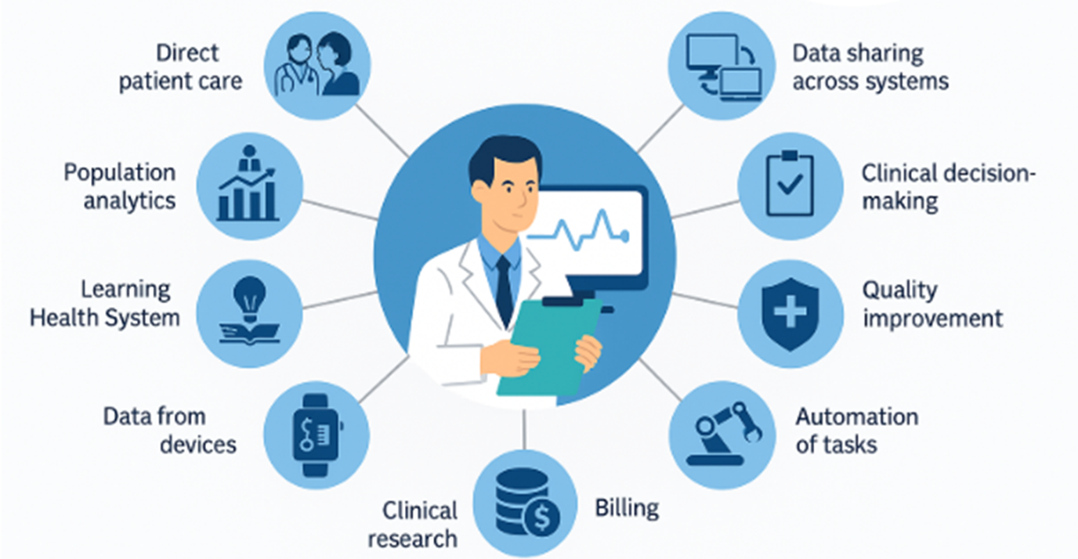

What uses of health data do we want to support?
© Regenstrief Institute, Inc.
Notes:
Keeping our focus on data,
If we ask ourselves
What uses of data do we want to support ?
The answer is ALL of them because we understand the power of health data.
We want data that improves direct patient care, enables data sharing across systems, and supports clinical decision-making at the point of care.
It’s also essential for public health reporting, quality improvement, and automating routine tasks—all of which depend on having clear, structured data.
And, as more data comes directly from devices, we need to ensure it integrates seamlessly with clinical systems.
And it doesn’t stop there. because
Health data is also vital for learning and discovery (pause)—from population analytics to supporting a Learning Health System that continuously improves based on real-world data.
Data powers clinical research, facilitates supply chain and inventory control, and yes—even supports billing and administrative workflows.
So when we say we want to support all health-related data, we mean data that serves every part of the health system—from the bedside to the back office, and everywhere in between
And at the very core of making that data usable, shareable, and meaningful [CLICK]—are data standards like LOINC.

Slide 5
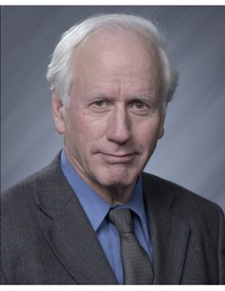
Brief history of LOINC
The global standard for identifying health
measurements and observations
Logical Observation Identifiers Names and Codes
Originated in 1994 by Clement McDonald, MD, Indianapolis, IN
Vision for health IT to help clinicians make better decisions
Need for a universal language for observations for electronic data exchange for clinical care, i.e., labs, hospitals, offices, payers
Clem McDonald, MD
© Regenstrief Institute, Inc.
Notes:
Now that we have had that background,
Lets take a deeper into LOINC and begin with some brief history.
LOINC which standards for Logical Observations, Identifiers, Names and Codes was created in 1994 and got its start at the Regenstrief Institute , in Indianapolis Indiana, and is the vision of Dr. Clem McDonald, who at the time, was Regenstrief Institute researcher.
Dr. McDonald and other thought leaders (one of whom is here with us today) had a vision that information technology should help clinicians make better decisions during the course caring for their patients.
And this vision would be realized by having a universal language called LOINC
CLICK
which today is recognized as a global standard for identifying health measurements and observations.

Slide 6
Scope
Over 108,000 concepts and growing
4 major categories of terms
Laboratory LOINC
Clinical LOINC
Survey Instruments
Documents
© Regenstrief Institute, Inc.
Notes:
I am going to talk about the scope of LOINC content at a high level here.
Introducing LOINC : LOINC is the database which content is the standard for Laboratory observations identifiers Names and Codes as Dr Rallins introduced previously.
LOINC Database contains over 108k concepts and is growing fast due to the need to standardized terminologies in general and for LOINC codes specifically,
There are 4 high level categories, and each category has multiple class which we will be discussing in the upcoming slides.:
1- Laboratory LOINC
2- Clinical LOINC
3- Survey Instruments
4- Documents

Slide 7

Laboratory LOINC
Routine testing
Inpatient hospital lab
Outpatient lab
Testing done in providers’ offices
Tests performed by patients
Specialized laboratory testing (“sendout”)
Newborn screening
Veterinary
Public health/Epidemiology
© Regenstrief Institute, Inc.
Notes:
The scope of laboratory LOINC includes the full spectrum of laboratory tests from Microbiology and Chemistry to genetic testing, etc whether done routinely in the hospital, in outpatient setting , or in provider office or done by the patient at home.
There are specialized tests such as those that need to be sent out to other places like the CDC which is a common practice today
And there are tests that are focused on the patient type such as whether it is a newborn human patient or a veterinary patient.
And there are tests to support larger scale like public health and epidemiology needs.
45 seconds; .75 minutes

Slide 8

Clinical LOINC
Clinical terms include all types of measurements, procedures, documents, and other clinical information that are not in the laboratory domain:
Anthropomorphic measurements, e.g., BMI, body weight, eye color, vital signs, history and physical exam findings
Procedures such as EKG, Echocardiography, OB ultrasound
Radiology procedures
Ophthalmology
Clinical notes
© Regenstrief Institute, Inc.
Notes:
Clinical LOINC includes concepts that are measurements, descriptive of procedures,
1- Measurements as in Anthropomorphic measurements, Measurements not laboratory oriented or in Laboratory domain, vital signs (Blood pressure , temperature, ect…) and physical exam finding as (RoS Review of Systems as in eye color, skin color, ..)
2- Procedures as in Radiology with various modules like MRI, Computerized tomography scanning, X-rays…, procedures like EKG, echocardiograms, and interventional procedures as in Fine needle aspirations, fluoroscopic guidance, Ejection fraction and so forth…
3- Clinical and Domain specialties like Ophthalmology, OB GYN, gastrointestinal, pulmonary and others…
4- Not to forget to mention about clinical notes, progress notes, consultation, and referrals …

Slide 9

Survey concepts
LOINC survey concepts include concepts that patients may report on a survey, or a provider would include when completing a form about a patients care or health status
Include
Functional assessments/symptom indexes
Health related social needs
Behavioral health
Psychiatry
Substance abuse assessments
© Regenstrief Institute, Inc.
Notes:
The LOINC survey section includes concepts that patients may report on a survey or a provider would include when completing a form about a patients care or health status. Survey concepts can cover but not limited to:
1- Patient – reported outcomes, and provider forms
2- Assessments, and symptoms indexes (Pain assessment, Skin assessment, gate assessment)
3- Health related social needs: PhenX , and Gravity project
4- Behavioral health: psychiatry, Mental health , and substance abuse assessments

Slide 10

Documents
Wide range of health care documents
Provide consistent semantics and structure for documents exchanged between systems for many uses.
Distinguish Clinical note from patient reports
Document codes are used in HL7 C-CDA
Different from other categories by the amount and the type of core attributes defining Documents.
© Regenstrief Institute, Inc.
Notes:
Documents encompass a wide variety and range of health care documents. This category in LOINC provide a consistent semantic representation of a document by standardizing the purpose and the name of the document with a LOINC code. It is important to mention that it is important to differentiate Clinical notes (Documents) from patient reports that are generated as outcome of a specific procedure as in radiology report, pathology report, or an interventional procedure. The Documents we are displaying here are more geared toward communication of admission, progress note, or in response to a consultation or a referral. Concepts are widely used in HL7 and they are mapped to HL7 V2.x Document codes. They have their own concept model that define each concept.

Slide 11
Core concepts and structure
Scope of LOINC content
Why LOINC was born
Foundational principles behind the standard
How LOINC was created
How LOINC content is developed and maintained
1
2
3
4
5
© Regenstrief Institute, Inc.

Slide 12
In 1994 …
HL7 was new.
For the first time, we had the HL7 data exchange standard.
But everyone was using their own local codes.
There were no standard codes for representing the meaning of the data being exchanged.
Clem convened a small group of volunteers to see if we could agree on standard codes.
© Regenstrief Institute, Inc.

Slide 13
The HL7 Messaging Paradigm
Trigger Event
Order
System
A
System
B
Network
Result
© Regenstrief Institute, Inc.

Slide 14
HL7 V2 Result Message (ORU)
MSH|^~\&|||||19981105131523||ORU^R01|
PID|||100928782^9^M11||Smith^John^J|
OBR||||Z0063-0^BP^LN|
OBX||CE|8361-4^POSITION^LN||SIT^Sitting|
OBX||NM|8479-8^SBP^LN||138|mmHg|
Segment
Data Field
Component
© Regenstrief Institute, Inc.

Slide 15
OBX: an HL7 V2 name-value pair approach
Other data fields include, date of observation, identity of provider giving observation, normal ranges, abnormal flags
A code that identifies the datatype
of OBX-5 (Numeric)
OBX-5: Data
Status
OBX||NM|11289-6^Body Temp^LN||38|C^Cent^ISO+|||||F
A code that identifies the data in OBX-5
A code that identifies the units of numerical data in OBX-5
© Regenstrief Institute, Inc.

Slide 16
OBX: with a coded value
A code that identifies the datatype as a
coded element
The code is
from LOINC
The code is
from SNOMED
OBX||CE|883-9^Blood Group^LN||58460004^Group O^SCT|
A code that identifies the data in OBX-5 (ABO Blood Group)
OBX-5: Data
A code for Group O
© Regenstrief Institute, Inc.

Slide 17
How different terminologies fit into the data exchange model
Questions (LOINC)
Answers (from other terminologies)
(8661-1) Chief complaint:
(106203-3) Allergy:
(86255-7) Billing diagnosis:
(36908-20 Genes tested for:
(6463-4) Bacteria identified:
(41461-5) Virus identified:
Chest pain (SNOMED CT)
Penicillin (SNOMED/FDB/RxNorm)
Myocardial infarction (ICD)
Cystic fibrosis (HUGO HGNC)
Group A strep (ICSP)
Hepatitis C (ICTV)
© Regenstrief Institute, Inc.

Slide 18
The name-value pair pattern in the FHIR Observation Resource
Observation (DomainResource)
identifier : Identifier [0..*]status : code [1..1]« ObservationStatus! »
code : CodeableConcept [1..1] « LOINC ?? »
subject : Reference [0..1]« Patient|Group|Device|Location »
encounter : Reference [0..1] « Encounter »
effective[x] : Type [0..1]« dateTime|Period »
value[x] : Type [0..1]
« Quantity|CodeableConcept|string|Range|Ratio|Sampled Data|Attachment|time|dateTime|Period »
interpretation : CodeableConcept [0..1] « Observation Interpretation+ »
method : CodeableConcept [0..1] « Observation Methods?? »
© Regenstrief Institute, Inc.

Slide 19
The name-value pair pattern in the FHIR Observation Resource
Observation (DomainResource)
identifier : Identifier [0..*]status : code [1..1]« ObservationStatus! »
code : CodeableConcept [1..1] « LOINC ?? »
subject : Reference [0..1]« Patient|Group|Device|Location »
encounter : Reference [0..1] « Encounter »
effective[x] : Type [0..1]« dateTime|Period »
value[x] : Type [0..1]
« Quantity|CodeableConcept|string|Range|Ratio|Sampled Data|Attachment|time|dateTime|Period »
interpretation : CodeableConcept [0..1] « Observation Interpretation+ »
method : CodeableConcept [0..1] « Observation Methods?? »
Observation (abbreviated)
subject <patient identifier>
code (test code) from LOINC
value <the result of the test>
© Regenstrief Institute, Inc.

Slide 20
The name-value pair pattern in the FHIR Observation Resource
Observation (DomainResource)
identifier : Identifier [0..*]status : code [1..1]« ObservationStatus! »
code : CodeableConcept [1..1] « LOINC ?? »
subject : Reference [0..1]« Patient|Group|Device|Location »
encounter : Reference [0..1] « Encounter »
effective[x] : Type [0..1]« dateTime|Period »
value[x] : Type [0..1]
« Quantity|CodeableConcept|string|Range|Ratio|Sampled Data|Attachment|time|dateTime|Period »
interpretation : CodeableConcept [0..1] « Observation Interpretation+ »
method : CodeableConcept [0..1] « Observation Methods?? »
Observation (data instance)
subject: Doe, John; #12345 code: 8480-6, Systolic BP
value: 120 mmHg
© Regenstrief Institute, Inc.

Slide 21
Core concepts and structure
Scope of LOINC content
Why LOINC was born
Foundational principles behind the standard
How LOINC was created
How LOINC content is developed and maintained
1
2
3
4
5
© Regenstrief Institute, Inc.

Slide 22


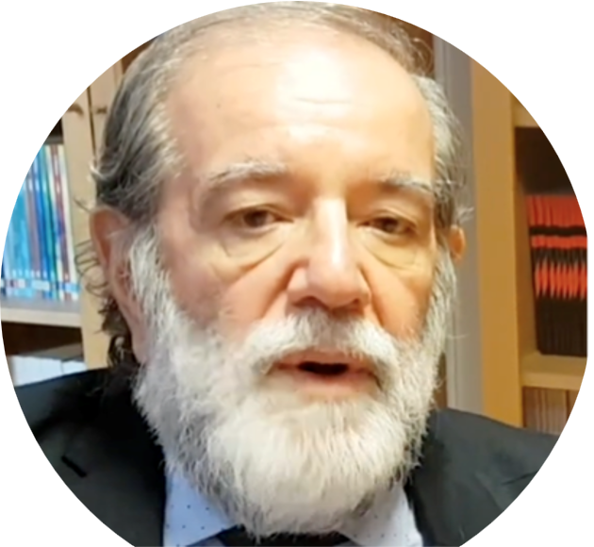
Seminal influencers on LOINC
Henrik Olesen
IUPAC Silver Book
Concepts of component, system, kind-of-property
Georges De Moor, Tom Fiers
EUCLIDES, OpenLabs
Theoretically compelling
Complete post coordination - 42 semantic axes
Angelo Rossi Mori
Archetypes
Tom Fiers
Georges De Moor
Angelo Rossi Mori
© Regenstrief Institute, Inc.

Slide 23
The LOINC code never stands alone…
The LOINC code alone never has all of the information that would make data instances semantically interoperable
You also need unit of measure, interpretation, priority, reference range, device/instrument/test kit, method, reagents, provenance data, …
© Regenstrief Institute, Inc.

Slide 24
Focus and Goals
LOINC codes are the value for:
The ‘Observation Identifier’ (Seq. #3) of OBX
Or the “code” attribute in the FHIR Observation Resource
Or the name of the observation in other standards, such as DICOM, CDISC, and C-CDA
Create individual result names first, then panels (batteries)
Panels are built based on the tests or questions they contain
Panels can contain other panels
Names should facilitate automated or manual matching (fully specified)
Create local labels as needed
Standard LOINC short names
© Regenstrief Institute, Inc.

Slide 25
Avoiding combinatorial explosion
Interface A (variable representation, rheumatologist view)
OBX|1|CE|4821-5^HLA-B27^LN|1|60373001^Detected^SNI|
(this approach causes creation of a LOINC code for each HLA type)
Interface B (value representation, transplant, or paternity view)
OBX|1|CE|4694-6^HLA-TYPE^LN|1|34453005^B27^SNI|
(this allows reuse of the HLA Type as the value of the result)
© Regenstrief Institute, Inc.

Slide 26
Data entry style and combinatorial explosion
Hair Color
Hair Color
Brown
Brown
Brown
Blonde
Red
Blonde
Red
Finding
Brown hair
Brown hair
Blonde hair
Red hair
© Regenstrief Institute, Inc.

Slide 27
Foundational assumptions
There should be one LOINC code for things that have the same clinical meaning, and conversely there are different codes for different meanings
A sodium level is never used in place of a potassium level
A urine sodium level is never used in place of a serum sodium level
But are bilirubin levels done by different methods the same?
Conclusion: In some cases, “sameness” is in the eye of the beholder!
© Regenstrief Institute, Inc.
Notes:
Same clinical meaning details
The decision is easy for most things. Things that have a different component never have the same meaning. A sodium level is never used in place of a potassium level. A serum sodium never has the same clinical meaning as a urine sodium. Things that have different ”kind of properties” don’t have the same meaning.
However, do bilirubin measurements done by different methods have the same clinical meaning? Different use cases (patient care, research, public health) may have different views of what things are the “same.”

Slide 28
Foundational assumptions (part 2)
When possible, all available information should be sent in the message, and then let users determine what things are the “same” for their purposes
Whenever possible, units of measure, method, device, anatomic location, reference range, etc. should be included in the message
We want to use LOINC codes to represent the data in patient data stores, not just in data exchange messages
If we use LOINC codes in the primary data store, then we don’t need to translate and transform the data for secondary use
© Regenstrief Institute, Inc.
Notes:
Same clinical meaning details
The decision is easy for most things. Things that have a different component never have the same meaning. A sodium level is never used in place of a potassium level. A serum sodium never has the same clinical meaning as a urine sodium. Things that have different ”kind of properties” don’t have the same meaning.
However, do bilirubin measurements done by different methods have the same clinical meaning? Different use cases (patient care, research, public health) may have different views of what things are the “same.”

Slide 29
Core concepts and structure
Scope of LOINC content
Why LOINC was born
Foundational principles behind the standard
How LOINC was created
How LOINC content is developed and maintained
1
2
3
4
5
© Regenstrief Institute, Inc.

Slide 30
Collect result names and descriptions IH, VA, Regenstrief, May Clinic, commercial lab systems
Formulate a model Represent individual pieces of information
Create “Fully Specified Names”
Adjust concept model as needed Do any distinct entities have the same name?
Repeat process until no more adjustments are needed
Approach used for developing LOINC codes
© Regenstrief Institute, Inc.

Slide 31
The data model that resulted from the code creation process: The Classic Six Axis LOINC Model
<component>:<property>:<timing>:<system>:<scale>:<method>
2947-0 SODIUM:SCNC:PT:BLD:QN
The first 5 axes (parts) are mandatory, but method is optional.
© Regenstrief Institute, Inc.

Slide 32
Core concepts and structure
Scope of LOINC content
Why LOINC was born
Foundational principles behind the standard
How LOINC was created
How LOINC content is developed and maintained
1
2
3
4
5
© Regenstrief Institute, Inc.

Slide 33
Overview of the six primary axes
Component
Property
Timing
System
Scale
Method
© Regenstrief Institute, Inc.

Slide 34
Summary of the six primary axes
© Regenstrief Institute, Inc.
Component | The thing you are measuring
Property | The particular aspect of the thing you are measuring
Timing | The interval of time over which the observation or measurement was made
System | The specimen type for labs, or a body location for clinical measurements
Scale | The data type of the answer. How the result is expressed: quantitative, semiquantitative, ordinal, nominal (coded), narrative
Method | Procedure or process used to make the measurement or observation

Slide 35
Component The thing you are measuring
Lab
Sodium
Glucose
White blood cell
Factor VIII
Hepatitis B surface antigen
Ribosomal RNA (RRNA)
DNA
Clinical
RR internal
Ejection fraction
Heart rate
Breaths
Cardiac output
Segmental wall motion
Fluid intake
© Regenstrief Institute, Inc.

Slide 36
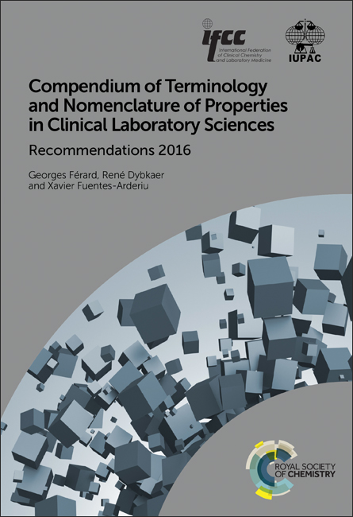
© Regenstrief Institute, Inc.
Property The particular aspect of the thing you are measuring
Kind-of-property follows the style of the IUPAC book Compendium of Terminology and Nomenclature of Properties in Clinical Laboratory Sciences, also known as the “Silver Book.”

Slide 37
Property The particular aspect of the thing you are measuring
Lab
MCnc – mass concentration
SCnc – substance (molar) concentration
NCnc – number concentration
MRat – mass rate
MFr – mass fraction
Titr – titer
CAct – catalytic activity
CCnc – catalytic concentration
Clinical
Prid – presence or identified
Color – color
Elpot – voltage
Len – length
Mass – mass
MRat – mass rate (gm/hr)
Pres – pressure
Temp – temperature
Aper – appearance
© Regenstrief Institute, Inc.

Slide 38
Timing The interval of time over which the observation or measurement was made
Lab
Pt – at a point in time
1D – 1 day specimen collection
24H – 24-hour specimen collection
Times – the timing is in a separate field of the message
Clinical
Pt - at a point in time
Stdy^min – minimum over the period of a study
24H - a twentyfour hour shift
10H^mean – mean value for a ten-hour period
8H^max – maximum value in an eight-hour period
© Regenstrief Institute, Inc.

Slide 39
© Regenstrief Institute, Inc.
System The particular aspect of the thing you are measuring. The specimen type for labs, or a body location for clinical measurements.
Lab
Bld – blood
Ser – serum
Plas – plasma
Ser/Plas – serum or plasma
Urine – urine
CSF – cerebral spinal fluid
PPP – platelet poor plasma
Tiss – tissue
Hair – hair
Clinical
Upper GI tract
Tricuspid valve^Patient
Tricuspid valve^Fetus
Synovial space
Heart.ventricle.right
Ventilator
Arterial system
Bladder
Eye.left

Slide 40
System – patient, control, or donor (as part of system)
Examples PPP^Control (clotting studies) Bld^Donor (blood donor ABO+Rh typing) Bld^Fetus (Rh disease analysis) ^Patient (when the whole patient is the system ) Ser If the super system is blank, it is assumed to mean “patient”
© Regenstrief Institute, Inc.

Slide 41
Scale The data type of the answer. How the result is expressed: quantitative, semiquantitative, ordinal, nominal (coded), narrative. Scales are the SAME for lab and clinical.
Qn - quantitative 4, 7.4, 1:8 SemiQn – semi-quantitative (discontinuous numeric quantities) 1:4, 5-10, Ord - ordinal, the answers can be ranked +/-, 1+, 2+, 3+ …. mild, moderate, severe none, rare, few, moderate, many, loaded | Nom - nominal, answers are coded but unranked Stool appearance – liquid, formed Skin color – pink, dusky, cyanotic Chest tube type Nar - answer is a two or more words of natural language, or as much as a paragraph of text Doc – document, a collection of two or more data elements
© Regenstrief Institute, Inc.

Slide 42
Method Procedure used to make the measurement or observation. Only used when it makes an important distinction in sensitivity or specificity.
Lab
Automated – automated
Bioassay – bioassay
Calculated – calculated
Comp fix – complement fixation
EIA – enzyme immunoassay
Electrophoresis – electrophoresis
Microscopy – microscope
Test strip – test strip
Wintrobe – for sedimentation rate
Clinical
Stated – reported verbally
Measured – actually observed
Estimated – an educated guess at the real value
Calculated – numeric calculation from a formula
US – ultrasound
EKG – electrocardiogram
Helium rebreathing – helium rebreathing
Spirometry – spirometry
Manual – done by hand
Automated – measured with a device
© Regenstrief Institute, Inc.

Slide 43

Types of LOINC Concept Names
Fully Specified Name (FSN) - unique
2341-6 Glucose:MCnc:Pt:Bld:Qn:Test strip manual
Long Common Name (LCN) - unique
2341-6 Glucose [Mass/volume] in Blood by Test strip manual
Short Name
2341-6 Glucose Bld Manual Strip-mCnc
© Regenstrief Institute, Inc.

Slide 44
Examples of fully specified LOINC names
Sodium :SCnc :Pt :Ser :Qn
Sodium :Scnc :Pt :Ur :Qn
Sodium :SRat :24H:Ur :Qn
Gentamicin^trough :MCnc :Pt :Ser :Qn
Calcium.free :SCnc :Pt :Ser :Qn
Protein.albumin :MCnc :Pt :Syn :Qn :Electropheresis
Ejection fraction :VFr :Pt :Cardiac ventricular.left :Qn :Angiogram
History of present illness :Find :Pt :^Patient :Nar :Reported
Physical findings :Find :Pt :Ear :Nom :Observed
© Regenstrief Institute, Inc.

Slide 45
LOINC makes names for things in use
We try to only make names and codes for things that are real (exist in someone’s system)
We do not make all possible permutations that the six axes would allow (no blind cross products)
We don’t make codes that represent yes/no questions for every diagnosis in SNOMED CT
We do make names that allow both atomic (post coordinated) and molecular (pre coordinated) styles
Some people wish we would be more prescriptive!
We name everything, let others make usage rules
© Regenstrief Institute, Inc.

Slide 46
Things that are never part of the LOINC code
We do not make names that include information that already exists as part of the HL7 message structure
Names never contain
Result status, order priority, units of measure
Provenance information
Ordering clinician
Performing lab
Specimen received time
Identity of the observer
Examples
Test priority is the message, so we don’t make LOINC codes that say, “Stat Serum Glucose.”
The performing lab is in the message, so we don’t make a code like, “ACME Lab Serum Glucose.”
But there are supportive LOINCs if these are in separate OBX segments
© Regenstrief Institute, Inc.

Slide 47
Use of XXX and {} (curly braces)
Old style
8319-6 BODY TEMP TEMP 12H^MIN XXX QN
New style
8319-6 BODY TEMP TEMP 12H^MIN {Body Loc} QN
LOINC codes of these styles imply that the code may be used in post-coordinated expressions OR when no body location is given
© Regenstrief Institute, Inc.

Slide 48
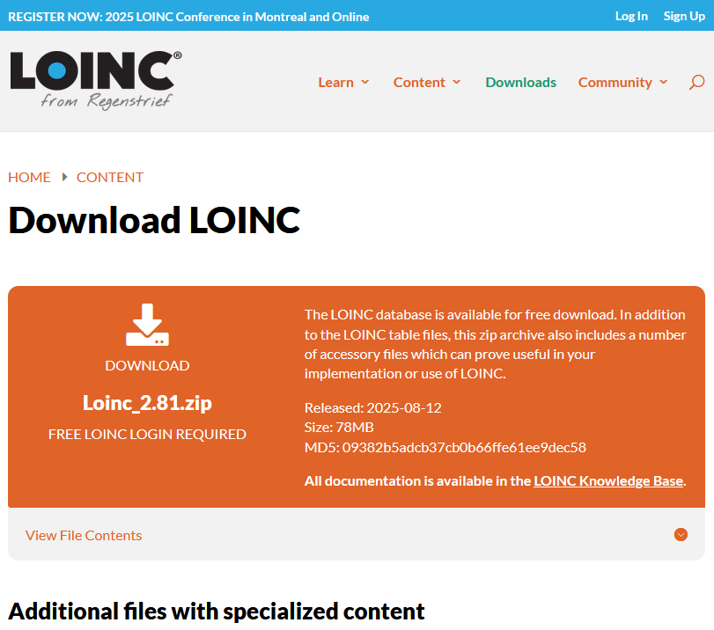

LOINC Download
loinc.org/downloads
© Regenstrief Institute, Inc.
Notes:
The most direct way to access LOINC is through the downloads page at loinc.org/downloads.
Over the years, we’ve simplified how the release is packaged. Originally, you had to download multiple zip files — one for the LOINC table and zip broken out into all the individual accessory files. This caused a lot of confusion about which files were needed.
Now we provide just one large zip file that contains everything. So whether you’re an implementer updating a terminology database or a researcher wanting the full dataset, you get everything you need in one place.
It’s important to note: downloads do require a login and agreement to the LOINC license, so users need an account.

Slide 49
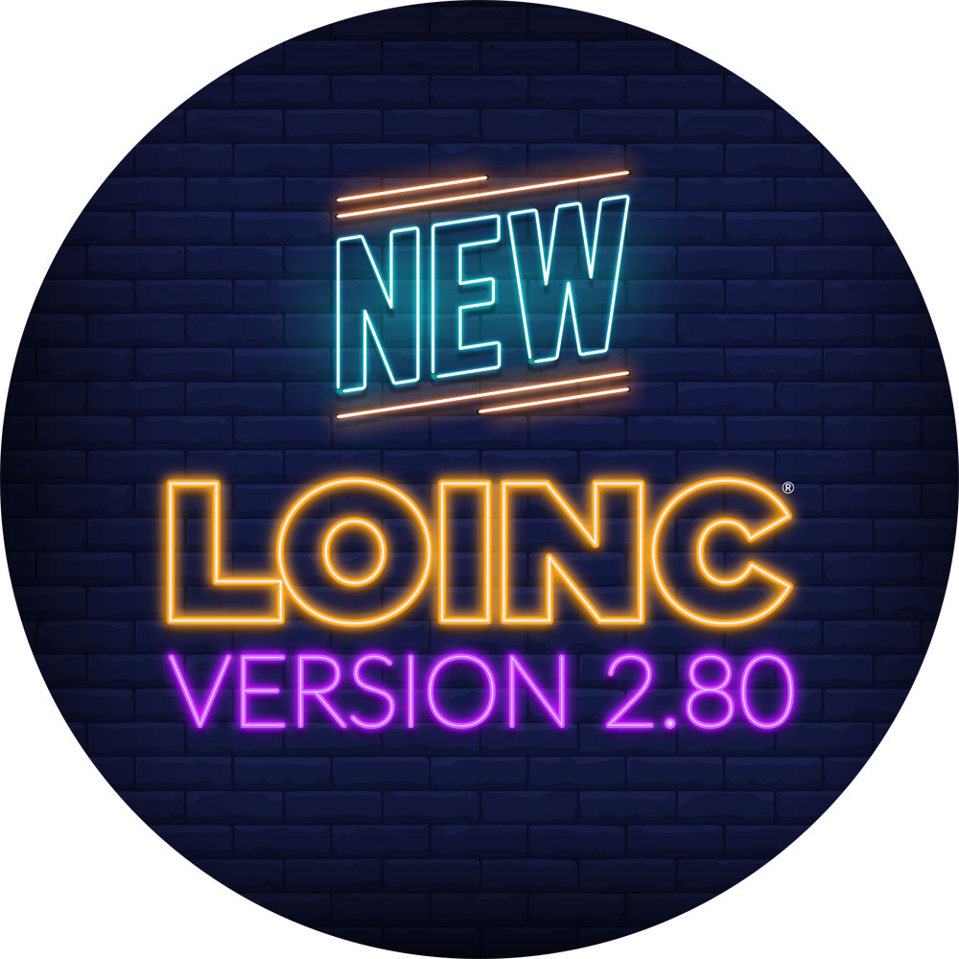
LOINC Download Release 2.82
What's in the release?
LOINC files
The main LoincTable files, including the Full and Core versions of the LOINC.csv file, Map To file, and Source Organization file.
Accessories
Supporting and supplementary files for LOINC such as Parts Answer Lists Panels and Forms Groups More
Read Me files
Comprehensive Read Me files are included for each release artifact. Read me files include file and directory structure information and detailed description of the contents of the files.
Release Notes
Previous versions of the release contained release notes as an artifact in the download, now they are available on the Knowledge Base.
© Regenstrief Institute, Inc.
Notes:
Let’s look more closely at what’s included.
In the package, you’ll find:
The main LOINC table — this is the heart of the release, containing all the terms.
Accessory files — things like Parts, Answer Lists, and Groups.
Documentation — read me for each artifact, change logs and reports, links to the release notes on the knowledge base.
For example, if you’re a lab adopting new codes, you’ll likely focus on the table itself. If you’re implementing survey instruments, you might care about the panels and forms accessory file

Slide 50


Thank you for coming!
© Regenstrief Institute, Inc.
Notes:
Thank you all for being with us today for LOINC Education Day.
We hope the sessions sparked new insights, gave you practical tools, and deepened your understanding of how LOINC can support your work.
It’s been wonderful to learn alongside such a diverse and engaged group.
Your participation, questions, and reflections are what make this day so valuable.
We look forward to carrying this momentum into the main LOINC Conference, which begins tomorrow.
I hope you’ll join us for the opening sessions as we continue to explore, share, and advance the use of data standards together.
On behalf of the entire team, thank you again for spending your day with us.
We’ll see you tomorrow at the opening of the LOINC Conference!

Slide 51

Reference Slides
© Regenstrief Institute, Inc.

Slide 52
Exercise: Combinatorial explosion How much meaning do you put into the code?
© Regenstrief Institute, Inc.

Slide 53
Could this data entry style lead to combinatorial explosion?
Family History
Prostate cancer in father?
Yes
No
Breast cancer in mother?
Yes
No
© Regenstrief Institute, Inc.

Slide 54

Could this data entry style lead to combinatorial explosion?
Family History
Prostate cancer in father?
Yes
No
Breast cancer in mother?
Yes
No
© Regenstrief Institute, Inc.

Slide 55
Another way to do family history
Family History
Underlying data structure
Father
Family History {
Person {
Name,
Relationship
}
Condition {
Age at onset,
Diagnosis }
}
Condition
Prostate cancer
Prostate cancer
Bladder cancer
Arthritis
© Regenstrief Institute, Inc.

Slide 56

Interoperability Today
Legend:
shape = structure
color = terminology
Real World
Digital
World
Data Sharing and Re-use
Application
© Regenstrief Institute, Inc.

Slide 57
Interoperability in the Future
Real World
Digital
World
Data Sharing and Re-use
(no translation, just use it!)
Application
Legend:
shape = structure
color = terminology
© Regenstrief Institute, Inc.

Slide 58
Founding Lab LOINC Committee Members
Ray Aller
John Baenziger
Pam Banning
Jim Bristol
Tom Burgess
Jim Case
Linda Charles
Jim Cimino
Diane Dwyer
Arden Forrey
Andy Gajda
Norbert Goldfield
Brian Griffin
Ed Hazell
Gil Hill
Stan Huff
Kathy Kammerer
Dennis Leavelle
Diane Leland
Pat Maloney
Doug Martin
Clem McDonald
Bill Meilahn
Frank Stalling
John Stelling
Bill Thurston
Dan Yokota
© Regenstrief Institute, Inc.

Slide 59
Founding Clinical LOINC Members
James Barthel
Dean Bidgood
Bruce Bray
Bill Francis
Alan Golichowski
Karl Hammermeister
Anders Thurin
Barry Gordon
Warren Williams
James Campbell
Jim Cimino
Sue Bakken
Pat Wilson
Stan Huff
Doug Martin
Clem McDonald
Dan Pollock
Angelo Rossi Mori
Susan Matney
Jeff Suico
WayneTracy
Pavla Frazier
Lee Min Lau
Shaun Shakib
Bill Karitis
Thomas White
Steven Steindel
© Regenstrief Institute, Inc.

Slide 60
Literature References
McDonald CJ, Huff SM, etal. LOINC® a universal standard for identifying laboratory observations – a 5-year Update. Clinical Chemistry, 2003 (Accepted)
Huff SM, Rocha RA, McDonald CJ, De Moor GJE, etal. Development of the LOINC (Logical Observation Identifier Names and Codes) Vocabulary. Journal of American Medical Informatics Association, 1998, 5:276-292.
Dolin RH, Huff SM, Rocha RA, Spackman KA, Campbell, KE. Evaluation of a “Lexically Assign, Logically Refine”Strategy for Semi-Automated Integration of Overlapping Terminologies. Journal of American Medical Informatics Association, 1998, 5:203-213.
Forrey AW, McDonald CJ, DeMoor G, Huff SM , Leavelle D, Leland Fiers DT, Charles L, Griffin B, Stalling F, Tullis A, Hutchins K, Baenziger J. Logical Observation Identifier Names and Codes (LOINC) Database: A public use set of codes and names for electronic reporting of clinical laboratory test results. Clinical Chemistry, 1995.
© Regenstrief Institute, Inc.

Slide 61
Examples of fully specified LOINC names
Sodium :SCnc :Pt :Ser :Qn
Sodium :Scnc :Pt :Ur :Qn
Sodium :SRat :24H:Ur :Qn
Gentamicin^trough :MCnc :Pt :Ser :Qn
Calcium.free :SCnc :Pt :Ser :Qn
Protein.albumin :MCnc :Pt :Syn :Qn :Electropheresis
Ejection fraction :VFr :Pt :Cardiac ventricular.left :Qn :Angiogram
History of present illness :Find :Pt :^Patient :Nar :Reported
Physical findings :Find :Pt :Ear :Nom :Observed
© Regenstrief Institute, Inc.

