Slide 1
Building CDE Models for All: The Graphite Health Approach and a Hands-on Blueprint for Taiwan
Wanfang Hospital, Taipei
March 26, 2026
Stanley M. Huff, MD
Professor (Clinical) Department of Biomedical Informatics, University of Utah School of Medicine
Chair, Clinical LOINC Committee
Notes:
Welcome Back
We hope you enjoyed that excellent and thought provoking keynote by Dr. Ehrenfeld that definitely left us with some important call to actions.
And we hope you have had some time during the break for networking.
Now we would like to move to the next part of the program and talk about our vision for LOINC.
Earlier in the year, we celebrated LOINC’s 30th anniversary which is a tremendous milestone of 30 years of working together to improve health data and interoperability for better care and better health.
That was a time to reminisce, now we would like to take some time to look forward and talk about where LOINC is going next.
I am going to talk about where we are headed strategically and then Stan Huff, who Chairs the LOINC Clinical Committee will drill down a bit more and talk about where we are going with LOINC in terms of its content and concept model and the changes we are proposing to LOINC so that it continues to grow and evolve to meet the needs or interoperability, particularly semantic interoperability.

Slide 2

Topics
Lessons from the HELP System
Lessons from the HELP² System
Graphite Health and the Graphite Foundry
Brief demonstration of the CEM browser
Some existing model repositories
© Regenstrief Institute, Inc.
Notes:
With that broader context in place, we’ll shift our focus to the core concepts and structure of LOINC.
We’ll begin with the scope of LOINC— and its primary domains.
Then we’ll ask: Why was LOINC created? What problem is it designed to solve, and how has that purpose evolved over time?
We will talk about the foundational principles that guide LOINC and why they matter,
We’ll explore how LOINC content is developed, including its structure and the guidelines and heuristics that shape LOINC.
And it is here, that we will take a deeper into
the six-axis model—explaining how it defines each LOINC concept and why this model is essential for accurately identifying and exchanging health data.

Slide 3
Lessons from the HELP System

Slide 4
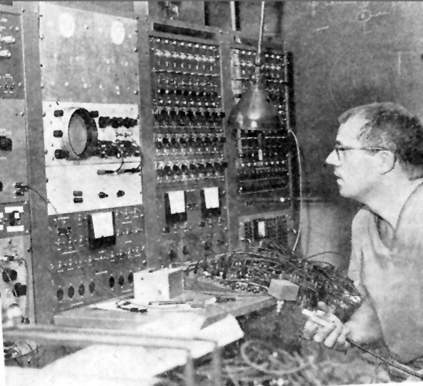
Homer Warner and HELP
The first version of the HELP (Health Evaluation through Logical Processing) system was in 1967
It was focused on cardiac care, and was built primarily to provide decision support
Dr. Homer Warner
Notes:
4

Slide 5
HELP System Summary
Development period: 1967 to 2012
Platform: NonStop Tandem (HP)
Database: Enscribe files, unique to HELP
Code system: PTXT (Pointer to Text)
ICD-9CM, SNOMED (1970’s version), First Data Bank
Primary User Environment: Inpatient
Types of users: Nurses, pharmacists, respiratory therapists, physicians
Number of commercial installations: 6
Number of Intermountain facilities: 23+
Number of Intermountain users: 13,000+

Slide 6
HELP System Assumptions
Patient centered record
System optimized for patient specific data access
Decision support integrated with patient care
Encoded (computable) data
Data retrieved in classes
Most recent data is most important (on average)
Variable length data
Data retrieved more often than stored
Cost capture in real time
Storage space is expensive

Slide 7
Need for coded data
Tom East’s experience with “Oral meds”
Oral, ORAL, Oral, ORALLY, Orally, ORALY, OR, or, PO, P.O., P.O, PO., po, per os, by mouth, … (26 variants)
Observation #1: You can not anticipate all of the ways that information can be recorded in free text.
Observation #2: You can not reliably execute real time decision logic against free text data
Conclusion #1: You need coded data

Slide 8
Lessons from HELP²

Slide 9
3M Care Innovation (HELP²) Summary
Development period: 1994 - 2014
Platform: UNIX on HP and IBM hardware
Database: Oracle
Code system: Healthcare Data Dictionary
LOINC, CPT, ICD-9 CM, UMLS Metathesaurus, First Data Bank
Primary User Environment: Outpatient and Inpatient
Types of users: Nurses, physicians, office staff
Number of commercial installations: 14
Number of Intermountain facilities: 100+
Number of Intermountain users: 8,000+

Slide 10
Goals of the system
High performance and reliability
Decision support integrated with patient care
Patient centered longitudinal record used for care in both inpatient and outpatient environments
Formal information model for detailed patient data
Standard coded terminology

Slide 11
Detailed clinical models at IHC
Use of ASN.1 as the formalism to describe the detailed models
Two generations of ASN.1 models
~6,000 detailed models were created
The system based on these models was in production use at 14 enterprises for 15+ years
3M HIS contributed a set of the ASN.1 models to HL7
IHC is creating a third generation of the models using CEML (an XML dialect) as the semantic model

Slide 12
CDR System Architecture (version 7.0)
XML
MMI Update Data Access
Data Store
Unix Server
External Clients
ASN.1
HTML
Web
Server
Event Manager
Alert Notify
Clinical Workstation
ASN.1
ASN.1
ASN.1
ASN.1
Web Results Review
ASN.1
Third Party SQL Tools
HL7 Interface Service
Clinical Alert Mgmt
HL7 2.3
Interface
Engine
Oracle Tables
Patient Data Objects (ASN.1)
Relational Patient Data Tables
Laboratory or
other Ancillary
System
Dictionary Data Objects (ASN.1)
Relational Dictionary Tables
Other Non- Patient Data (ASN.1)
Other Relational Tables
Notes:
All internal communications are in ASN.1
In the preferred scenario, the feeder system communicates with the I/F engine and the I/F engine sends the message direct to data store/access. In order to accomplish this the I/F engine acting as a Tuxedo client encodes the message via the dictionary services, and produces an ASN.1 message. STC and CAI are using this method of communication via TCP/IP.
Otherwise the I/F engine can send any HL7, fixed format, or other defined message structure to the interface router to encode the data and form the ASN.1 message. Hublink is using this method. (We charge more for this type of interface.)
We store the data as both and ASN.1 object, which allows improved performance for retrieval and in relational tables. Our applications use the ASN.1 form and in general, other third party tools will use the relational form. However, there is nothing to prevent them from using the same services our applications use to get the data in the ASN.1 form.
There are basically three categories of data, patient data, including the MMI, encounter, and clinical data, the dictionary data, and other data which can include such things as formularies, site specific configuration data, security tables, and other application specific data required for operation.
CW communicates directly through the OLE.
The event manager and alert notification while show separately are part of CAM. Data store sends data to the event manager for evaluation, if the data is needed for rule execution, then it is passed on to the CAM alert engine for evaluation. Depending on the rule, CAM will notify, return information to data store (in a feedback loop), or do nothing.

Slide 13
Using a detailed clinical model to create a data entry application

Slide 14
The complete asn.1 for WeightObs
WeightObs ::= PatientObservation (WCS {
obsId (RCodedTerm (WeightId)),
decUObsVal (MassUnits),
abnFlag (RCodedDomain (NumericAbnormal)),
deltaFlag (RCodedDomain (NumericDelta)),
refRange,
status,
reportFlag,
comments (RComments (PatObsComment)) ,
obsMods (WITH TYPES {
NormalizedWeightObs % ,
WeightMeasureInstrumentObs % ,
WeightMeasurementTypeObs % ,
PatConditionObs % ,
PatTimingObs % ,
WeightMeasureMethodObs % ,
OccurredAtOrDuringEventObs % ,
PatPositionObs % }) })

Slide 15
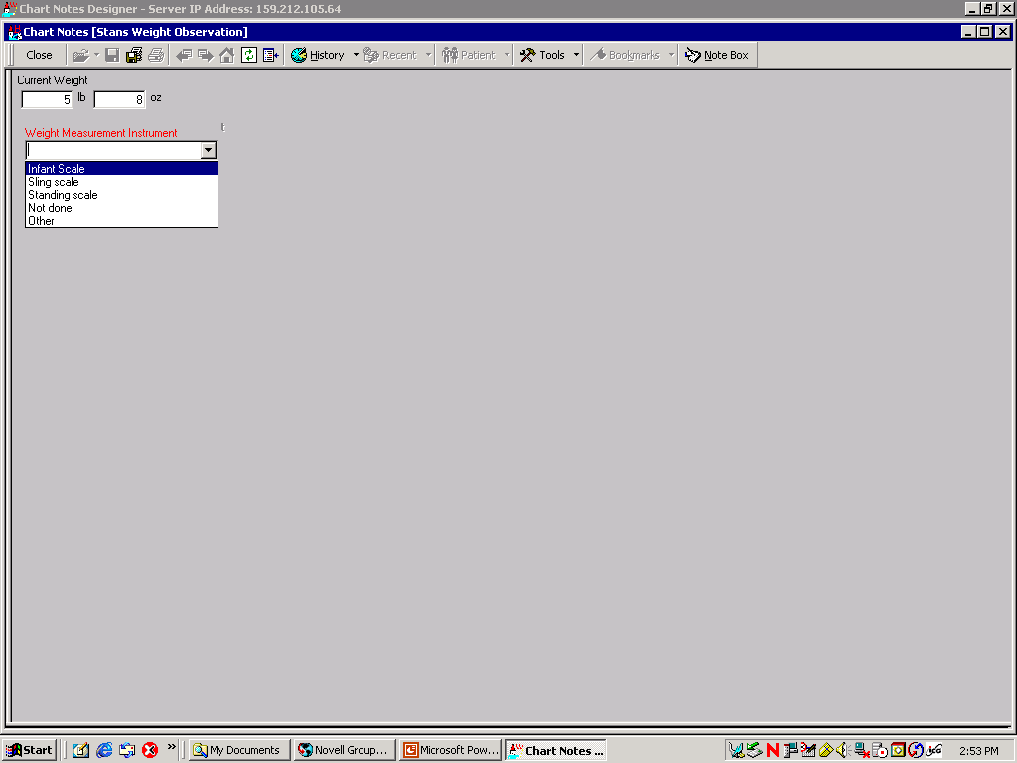
This is the data entry screen that we want to create using Chart Notes Wizard.

Slide 16
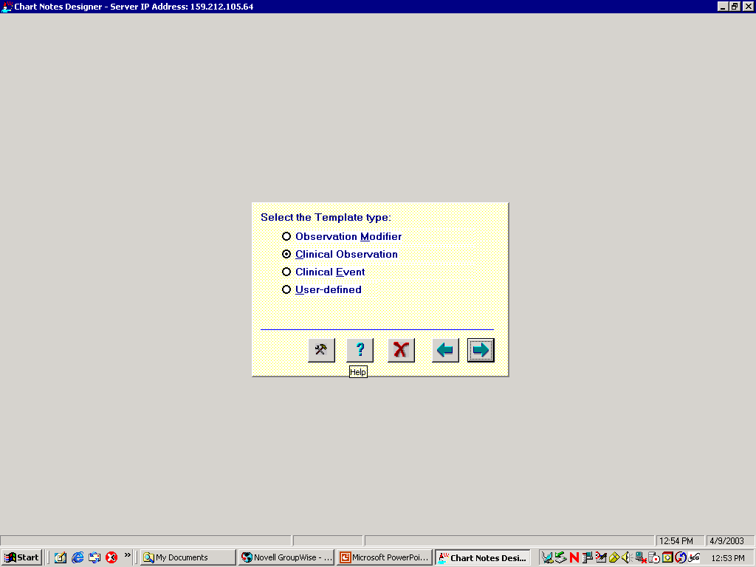

Slide 17
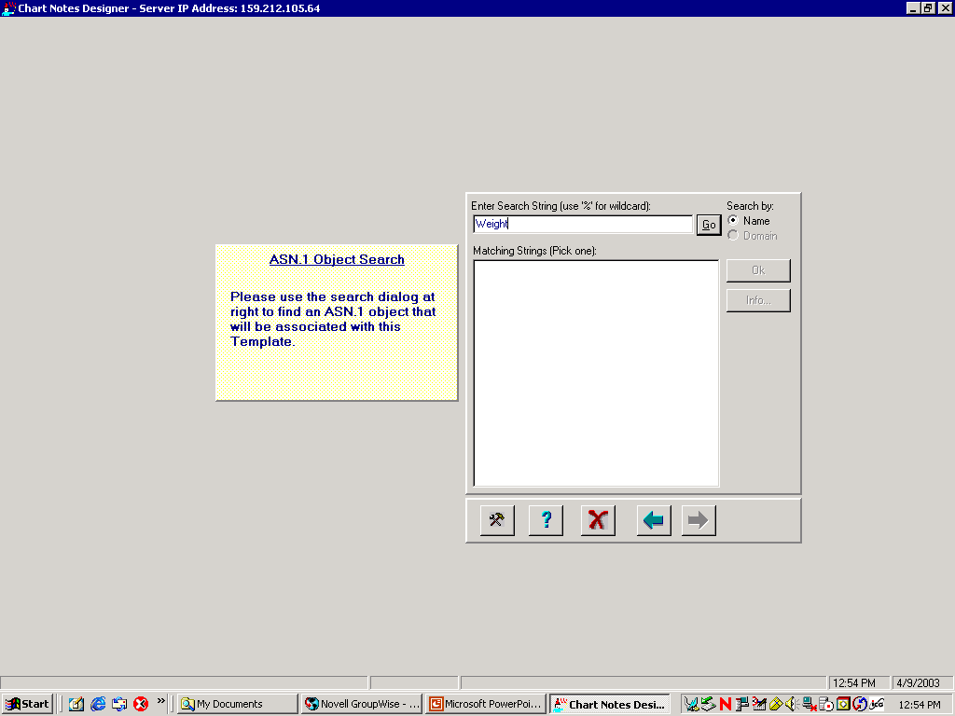

Slide 18
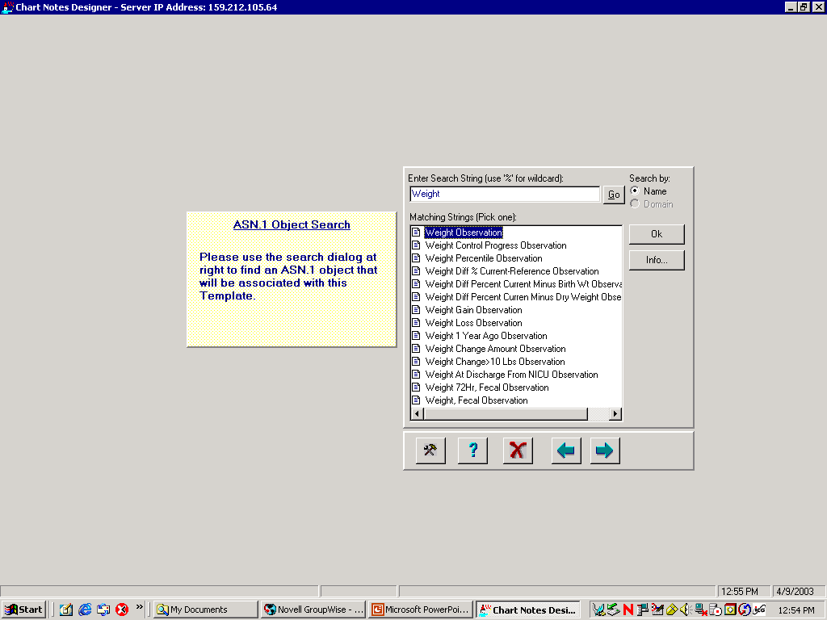

Slide 19
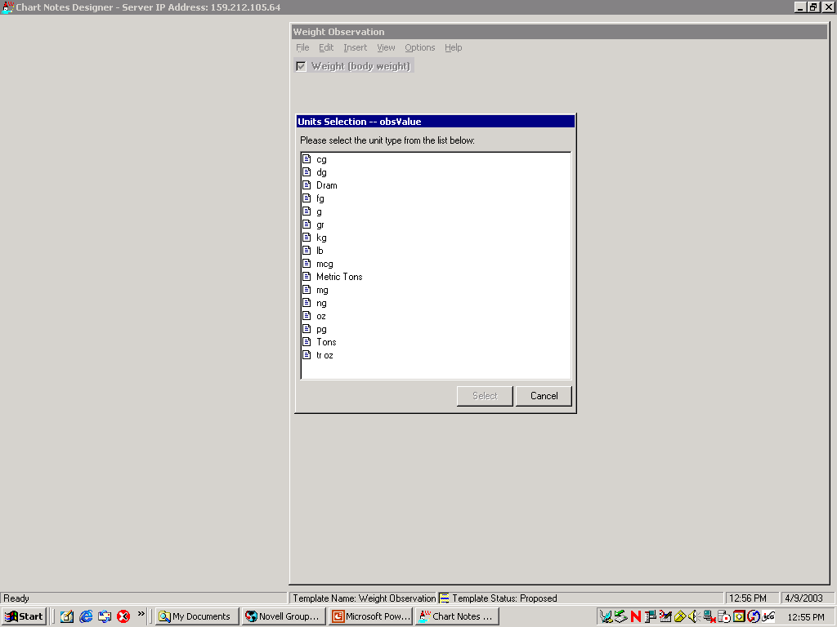

Slide 20
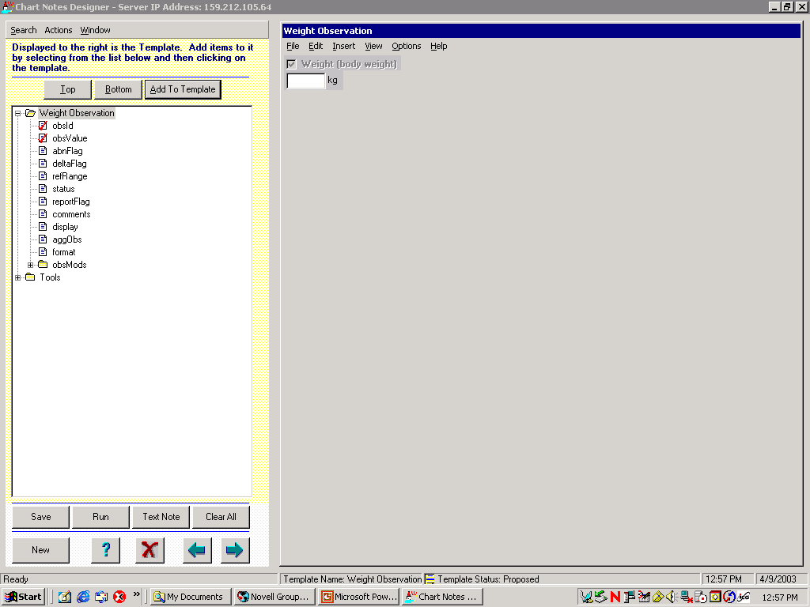

Slide 21
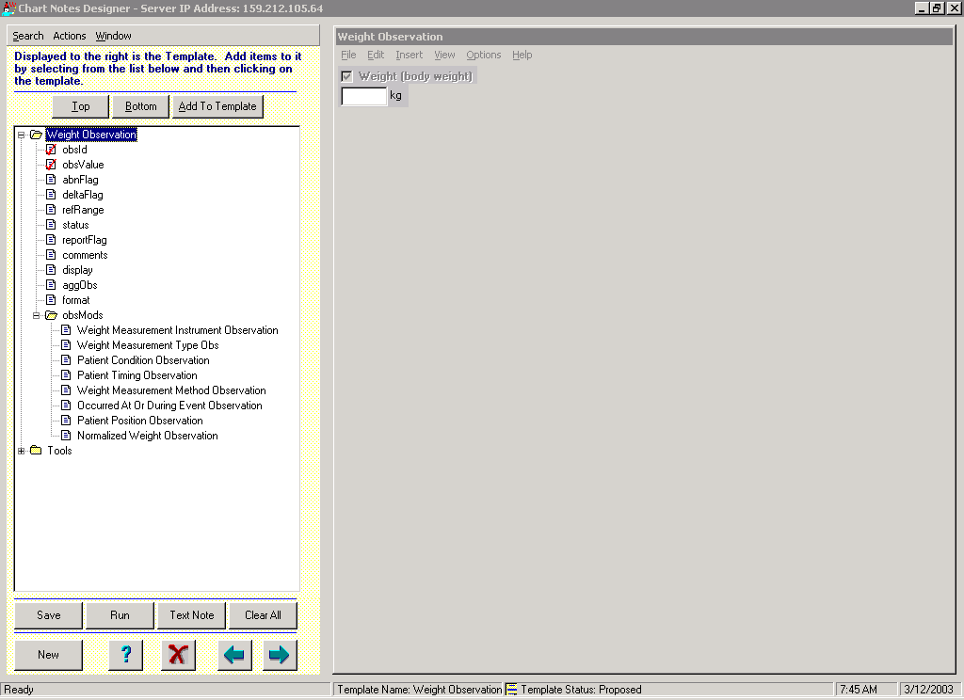

Slide 22
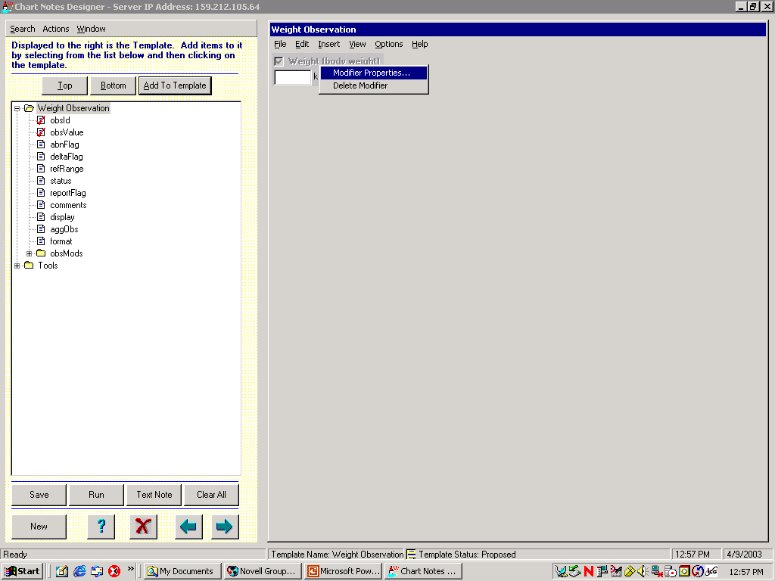

Slide 23
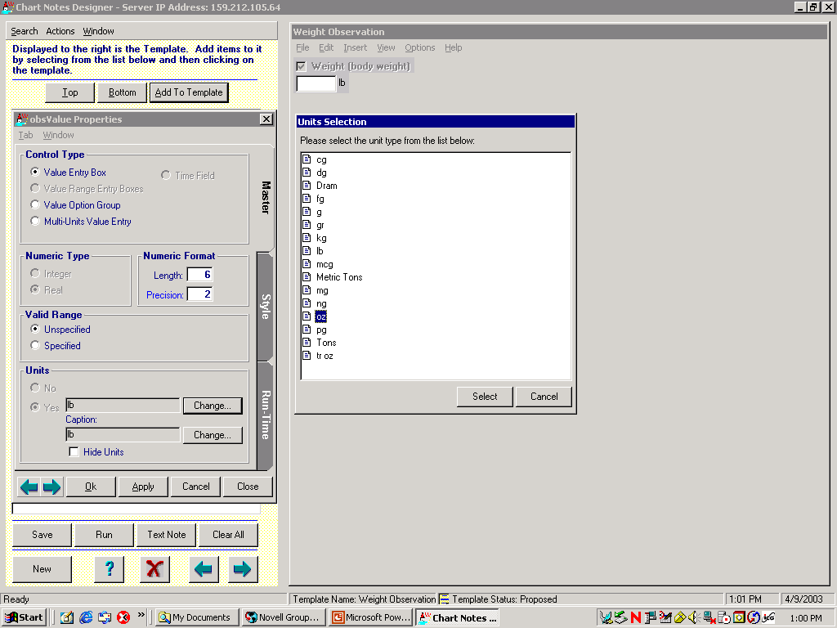

Slide 24


Slide 25
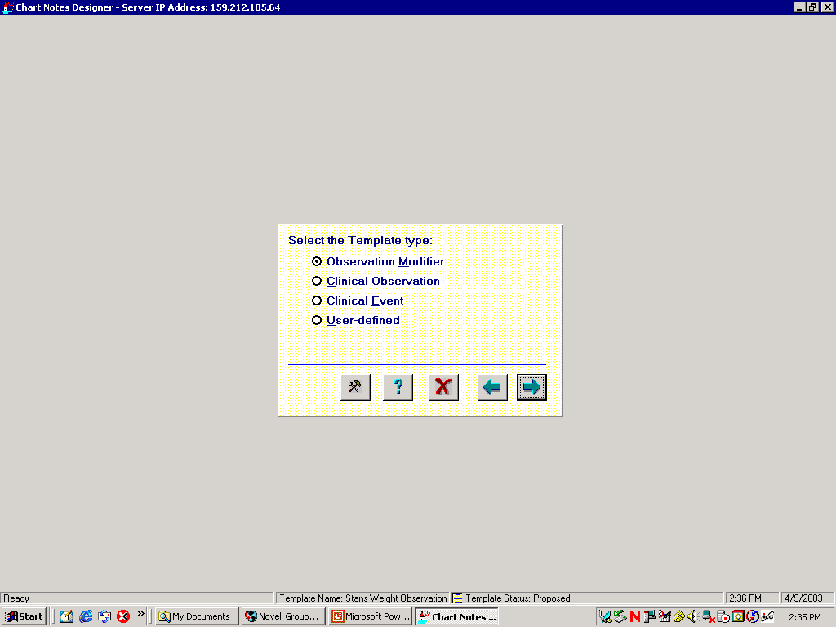

Slide 26
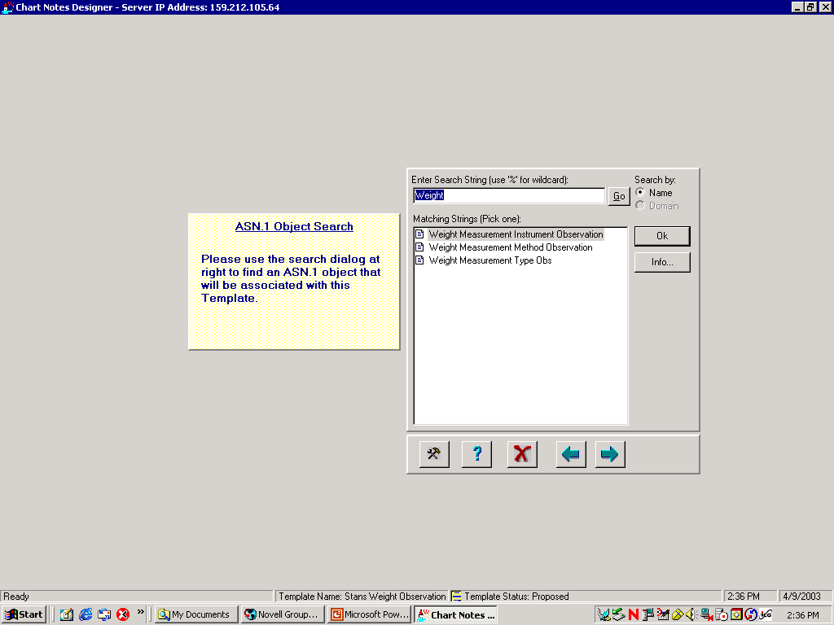

Slide 27
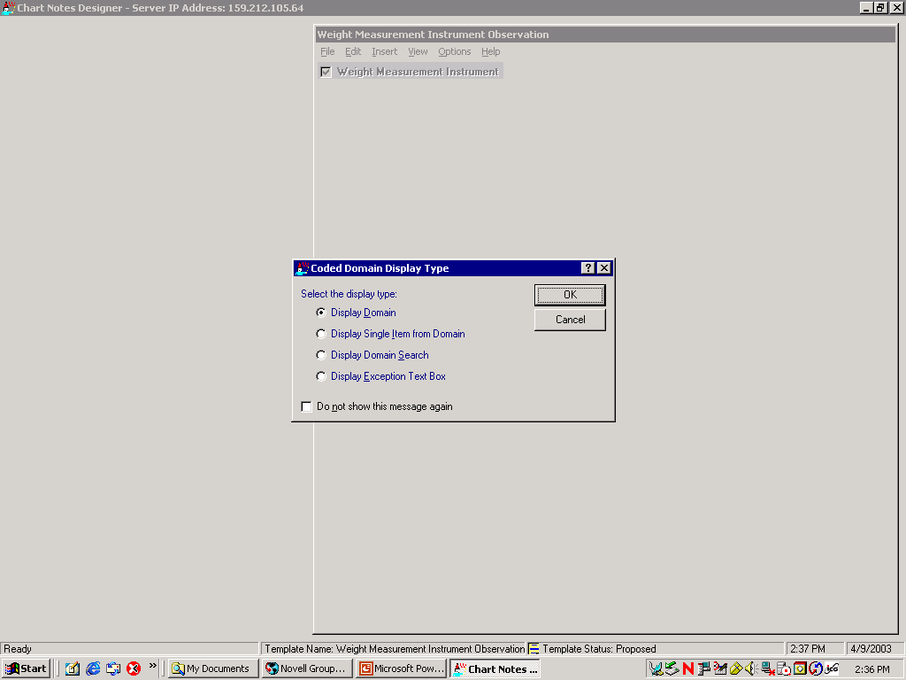

Slide 28
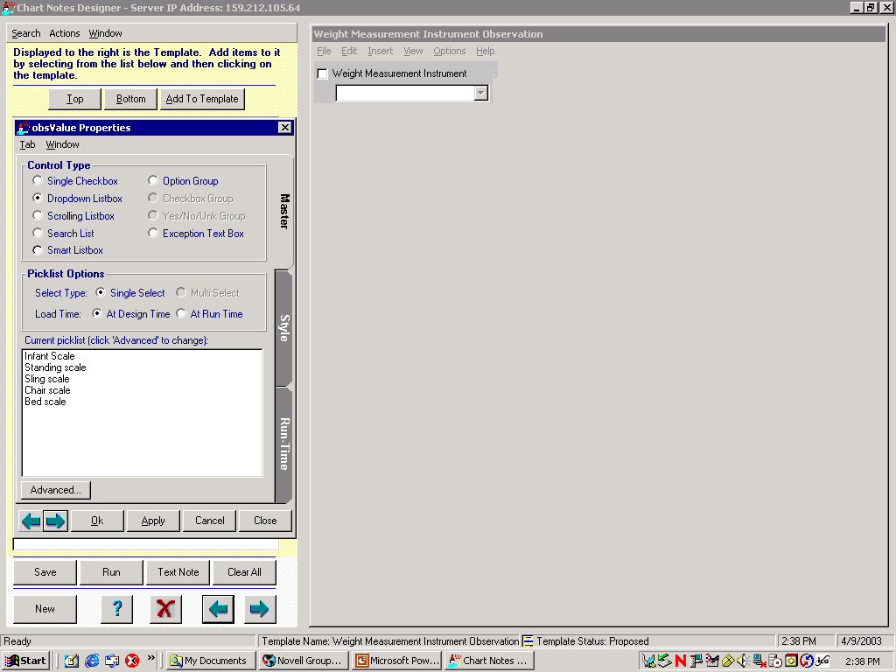

Slide 29
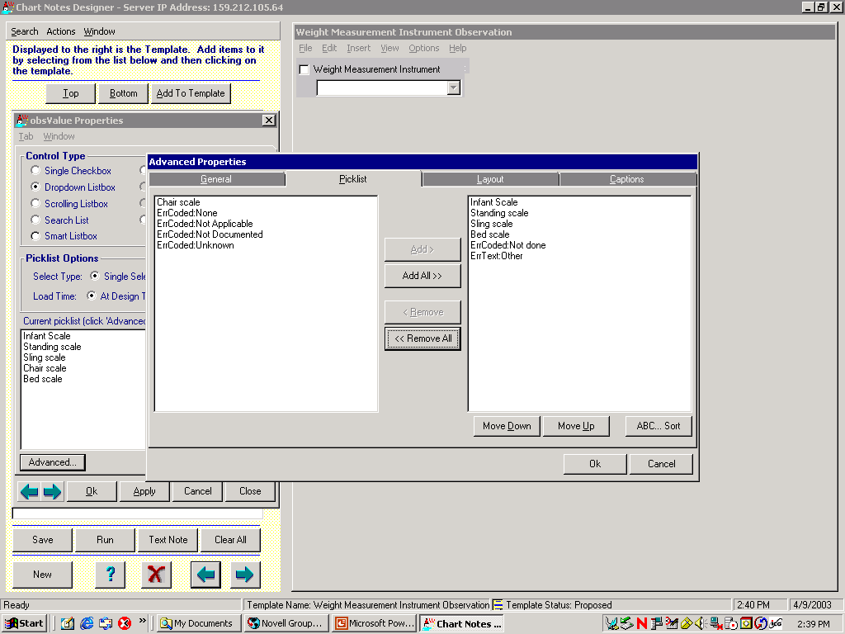

Slide 30


Slide 31
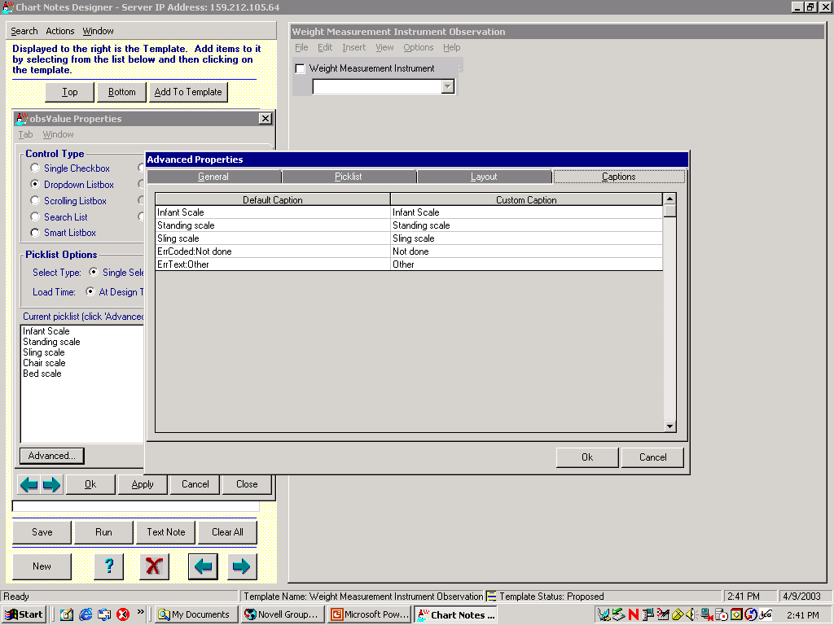

Slide 32
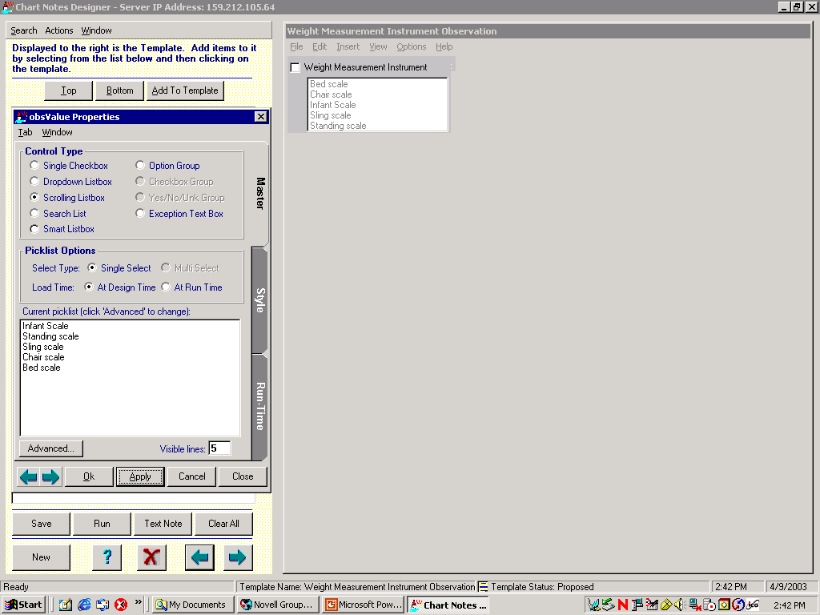

Slide 33
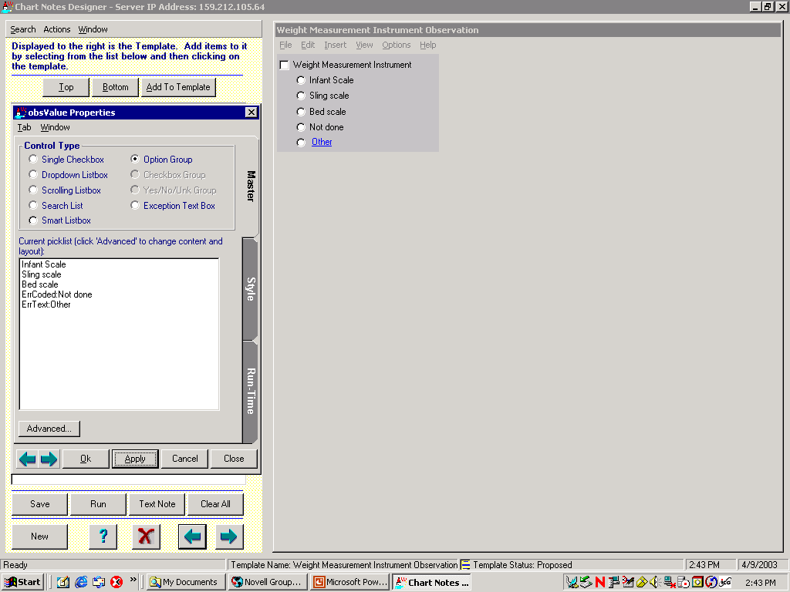

Slide 34
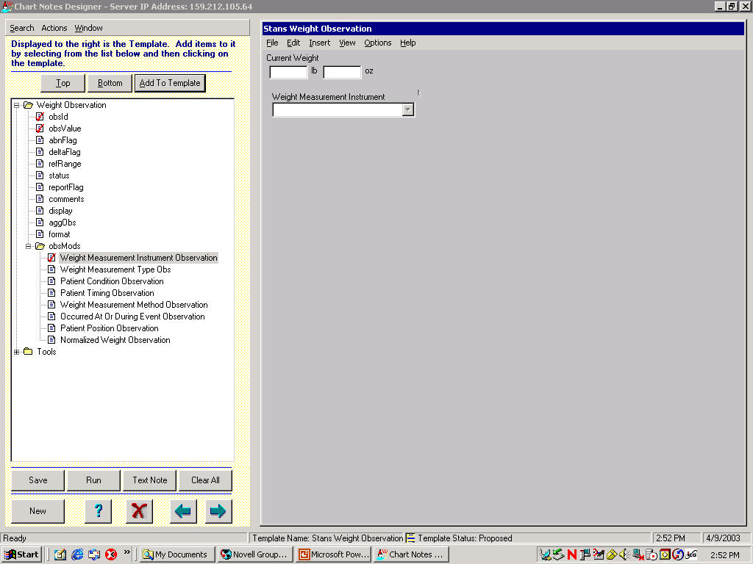

Slide 36
Graphite Foundry, INC.

Slide 37
Brief History of Graphite Health and Graphite Foundry
Graphite Health, INC. was established in 2019 as a not-for-profit Delaware Corporation
The founding members were: Intermountain Health, SSM Health, Presbyterian Health, and Kaiser Permanente
Graphite Health inherited ~7,500 CDEs/CEMs from Intermountain Health and Logica Health
There were 7 expert biomedical informaticist creating the models
Graphite Health went out of business in May 2025. As the major investor, Intermountain obtained all the IP rights to the models
Intermountain established a new company named Graphite Foundry, INC. in January 2026 as a not-for-profit Delaware Corporation
The new company is still being organized and is not yet functioning

Slide 38
Graphite Foundry
The vision of the Graphite Foundry is to enable an open semantically interoperable ecosystem for health and health care (see next slide)
The open models will be available when the company is operational
The things that the company will produce include:
A library of detailed clinical element models (aka CDEs, CEMs), starting with the models created by Intermountain, Logica, and Graphite Health
A mapping table for transforming data between isosemantic models (models that have identical meaning but different structures)
A library of FHIR profiles generated from the CEMs
A sandbox (development environment) where software applications can be developed and certified as compliant with the standard model

Slide 39



Open Interoperability Ecosystem
The role of information models in data standardization
STANDARDIZATION & POLICY
DEVELOPMENT LAB (sandbox)
MARKETPLACE
MODEL DEV. SERVICES
Open
STANDARD
ENGAGEMENT SERVICES
DEVELOPMENT ENVIRONMENT
Compliance CERTIFICATION
CERTIFIED
APPLICATIONS
INTEROPERABILITY PLATFORM
APPLICATION PLATFORM
Patient Data
Sources
STANDARDIZATION
SERVICE
DATA MANAGEMENT
SERVICE
FHIR
INTERNAL APPLICATIONS
PURCHASED APPLICATIONS
Could be
a PHR
Includes Generative and
Agentic AI
SYSTEM FIREWALL
SHARED TRUST ENVIRONMENT

Slide 40
Development of Technology Specific Artifacts
Transformation
Knowledgebase
HL7 FHIR
Profiles
(versions 1-6)
HL7 V2.X
IGs
Model
Library
Model
Transformation Widget
C-CDA
Templates
OMOP
Format
Others
Notes:
Defining the structural knowledge of medical data is the hard job. It is relatively easy to create cross compilers that create the different exchange syntaxes.

Slide 41
A brief demonstration of the model browser

Slide 42
Existing Model Repositories
Logica, Graphite Health, Graphite Foundry
Model language: Clinical Element Modeling Language (CEML)
Number of models ~7,500
Terminology binding
Uses LOINC, SMOMED CT, UCUM
Percent of coded elements with proper value sets - ~90%
openEHR
Model language: Archetype Definition Language (ADL)
Number of models – 1,640 (archetypes and templates)
Terminology binding
Uses local codes, LOINC, SMOMED CT, UCUM
Percent of coded elements with proper value sets - ~10%, mainly free text
Netherlands
Model language: Unified Modeling Language (UML)
Number of models ~108
Terminology binding
Uses LOINC, SMOMED CT, UCUM
Percent of coded elements with proper value sets (?)

Slide 43

Thank you for coming!
© Regenstrief Institute, Inc.
Notes:
Thank you all for being with us today for LOINC Education Day.
We hope the sessions sparked new insights, gave you practical tools, and deepened your understanding of how LOINC can support your work.
It’s been wonderful to learn alongside such a diverse and engaged group.
Your participation, questions, and reflections are what make this day so valuable.
We look forward to carrying this momentum into the main LOINC Conference, which begins tomorrow.
I hope you’ll join us for the opening sessions as we continue to explore, share, and advance the use of data standards together.
On behalf of the entire team, thank you again for spending your day with us.
We’ll see you tomorrow at the opening of the LOINC Conference!

Slide 44

Reference Slides
© Regenstrief Institute, Inc.

Slide 45
Strategic Concepts
People need help (decision support)
Patient centered record
Decision support integrated with patient care process
Clinical and administrative research
Capture data only once
Data capture is expensive in time and resources
Real time, at the point of care
Data content changes slowly
Technology changes quickly
No vendor does it all - you need to develop some things on your own development

Slide 46
Why ASN.1 objects AND relational tables?
ASN.1 Objects
Intuitive hierarchical structure
Fast retrieval for a complex clinical entity
CBC, Chem-7, Bacterial Culture, Medication Orders, Problem List
Relational tables
Index to object contents
Fast for cross-population search
Fast for access to a single attribute
Mature development environment and development tools
Standard query language, data export, 3rd party tools

Slide 47
Model Development Workflow
Narrative Health Records
Structured Health Records
Journal Articles
Textbooks
Existing Models
Terminology
Server
Draft 2
Value Set Creation and
Terminology
Mapping
NLP
LLMs, Generative AI
Silver
Draft Models
Model
Library
Human
Review
(Minimize!)
Bronze
Gold

Slide 48
Clinical Element Modeling Language (CEML)

Slide 49
Basic elements of the core model
Type - The name of a particular model
Key - Links the model to a concept in an external coded terminology.
Value Choice - Possible ways to convey the model’s value.
Notes:
Do not want to store LOINC, SNOMED code directly by design. We link to external coded terminology.
1. Impossible to correct errors made in standard terminology, I.e. SNOMED, unless change database. If use mapping, then can just change the mapping to correct the error.
2. Standard terminology makes mistakes.

Slide 50
Value Choice
Data - Value conveyed as an HL7 version 3 data type
Items - Value conveyed by multiple Clinical Elements collectively

Slide 51
A Simple Laboratory Observation CEM
SerumSodiumMeas (model name)
SerumSodium (LOINC code)

Slide 52
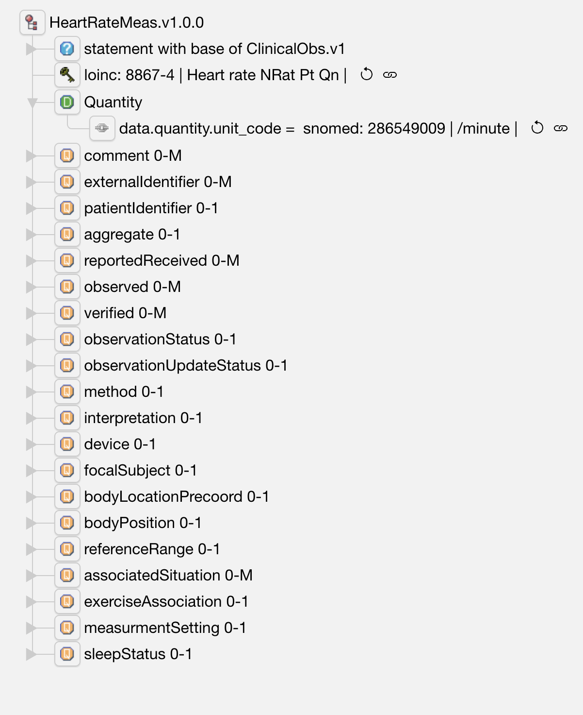
Heart rate Information Model (a CEM/CDE)

Slide 53
CEML Model for Heart Rate
cem HeartRateMeas.v1.0.0
kind statement
base ClinicalObs.v1
key HeartRate_CODE
data Quantity
elm bodyLocationPrecoord: BodyLocationPrecoord.v1
use qualifier
card 0-1
elm bodyPosition: BodyPosition.v1
use qualifier
…

